Slide 1
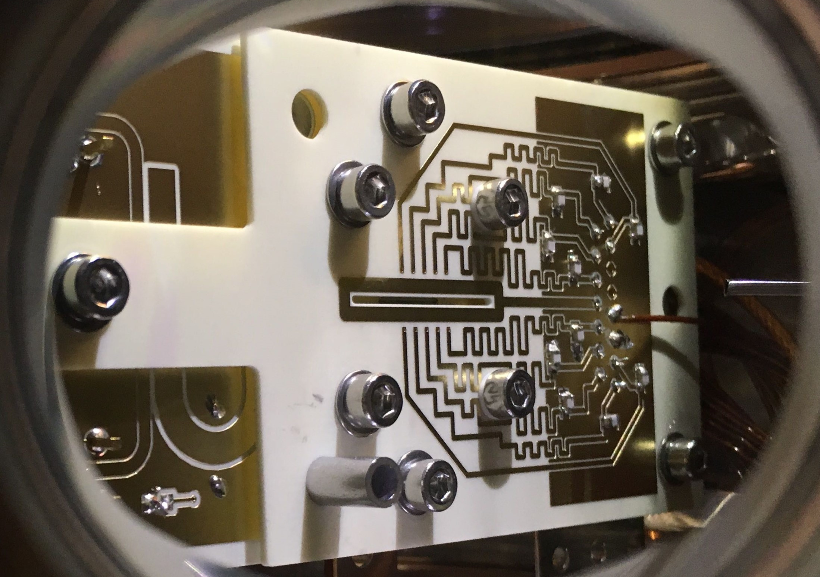
Towards a trapped electron quantum computer
Clemens Matthiesen, Qian Yu, Timothy Guo, Alberto Alonso, Hartmut Häffner
University of California, Berkeley
Quantum information processing
Motivation: electrons are the better ions
Trapping electrons
Set-up
Detection of electrons
Trap characterization
Outlook

Slide 2
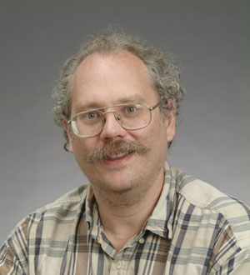
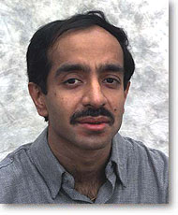
Taking advantage of quantum information
Schrödinger equation for 300 interacting spins requires more classical bits than there are atoms.
Quantum computers can solve certain tasks much more efficiently than classical computers.
Other prominent examples:
Factoring of large integers (P. Shor 1994)
Search in an unsorted data base (L. Grover, 1997)
Quantum chemistry calculations
….

Slide 3
Quantum computing
Classical computer
Quantum computer
Initialization
1-bit operations (NOT)‏
2-bit gates (e.g. NAND)
Computational space:
Read out result
Initialization
1-qubit rotations superpositions
2-qubit gates Matrix multiplication entanglement
Computational space: Hilbert space 2^{n} dimensional
State projection gain of classical information
00
01
10
11

Slide 4
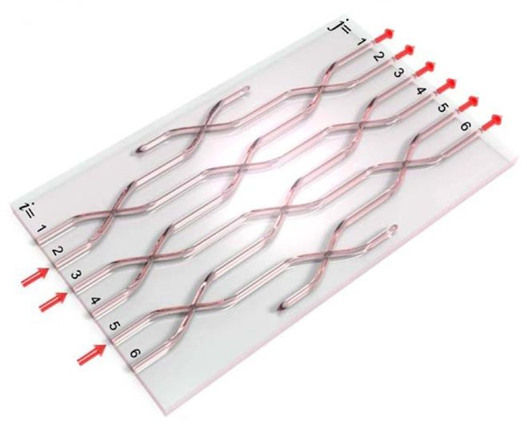
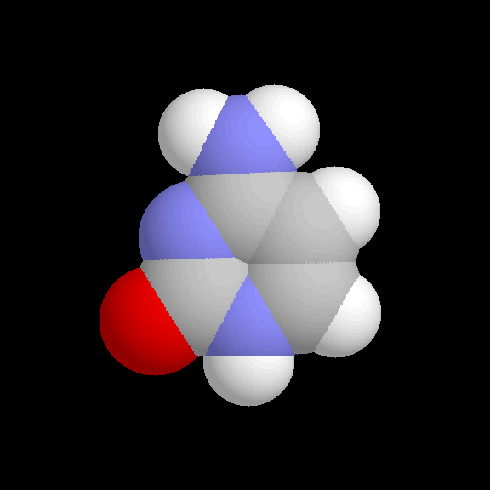
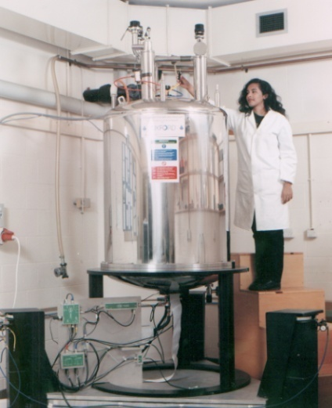
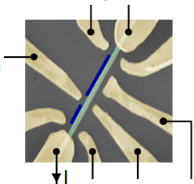
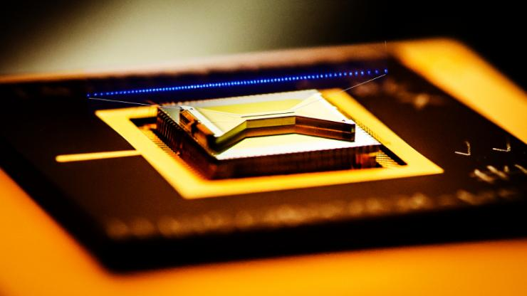
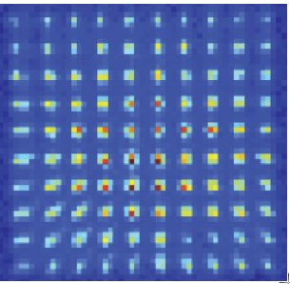
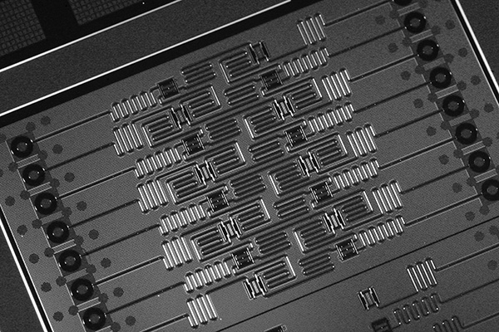
Which technology?
Quantum
processor
000
001
010
011
100
011
110
011
Photons
NMR
NMR
Quantum dots
Trapped ions
Rydberg atoms
Superconducting qubits
© A. Ekert, R. Blatt, K, Brown, H. Häffner, M. Saffmann, IBM, C. Marcus, I. Wamsley

Slide 5
DiVincenzo criteria
Scalable physical system, well characterized qubits
Ability to initialize the state of the qubits
Long relevant coherence times, much longer than gate operation time
“Universal” set of quantum gates
Qubit-specific measurement capability

Slide 6

Motivation:
trapped electrons are the better ions
http://staq.pratt.duke.edu/
Good:
High fidelity operations, state-of-the-art errors rates of 10⁻³ - 10⁻⁶
Modular
Potonic interconnects, error rate 10⁻²
Flexible connectivity (see NIST, Honeywell)
Module sizes of 20 ions have been demonstrated (Innsbruck, U Maryland, IonQ)
Long coherence, up to 2 hours
Bad:
Optics development required
Slow operations (tens of microseconds)

Slide 7
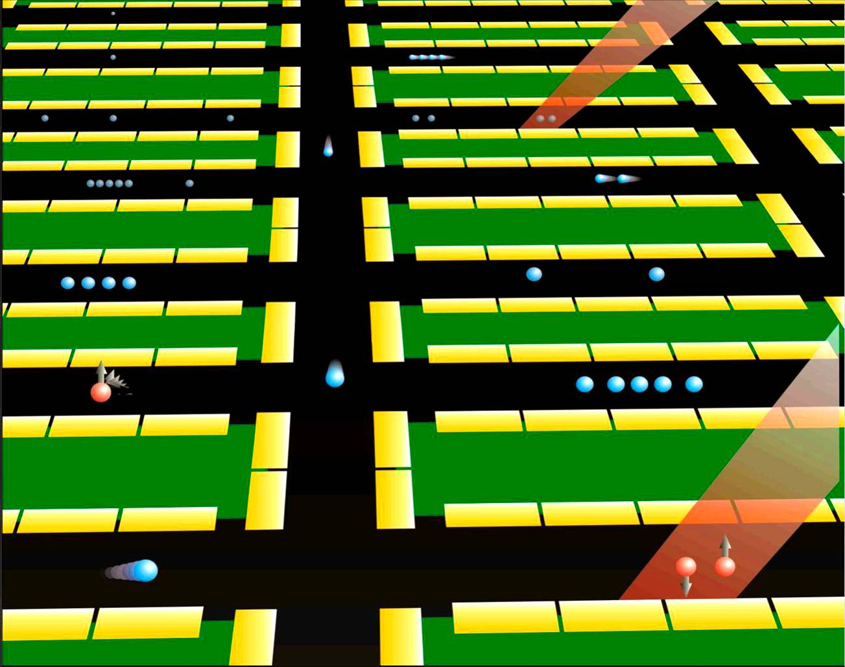
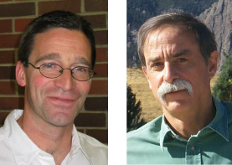
Motivation:
trapped electrons are the better ions
D. Leibfried, D. Wineland (NIST)

Slide 8
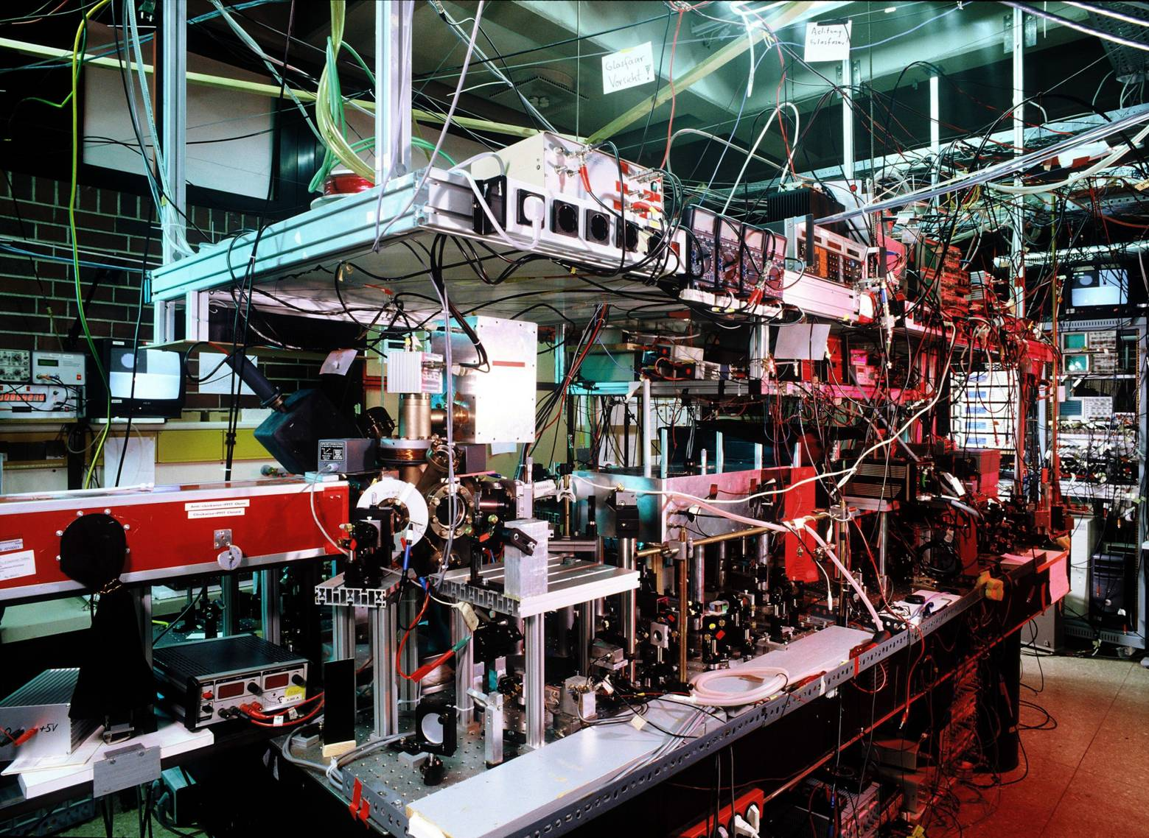
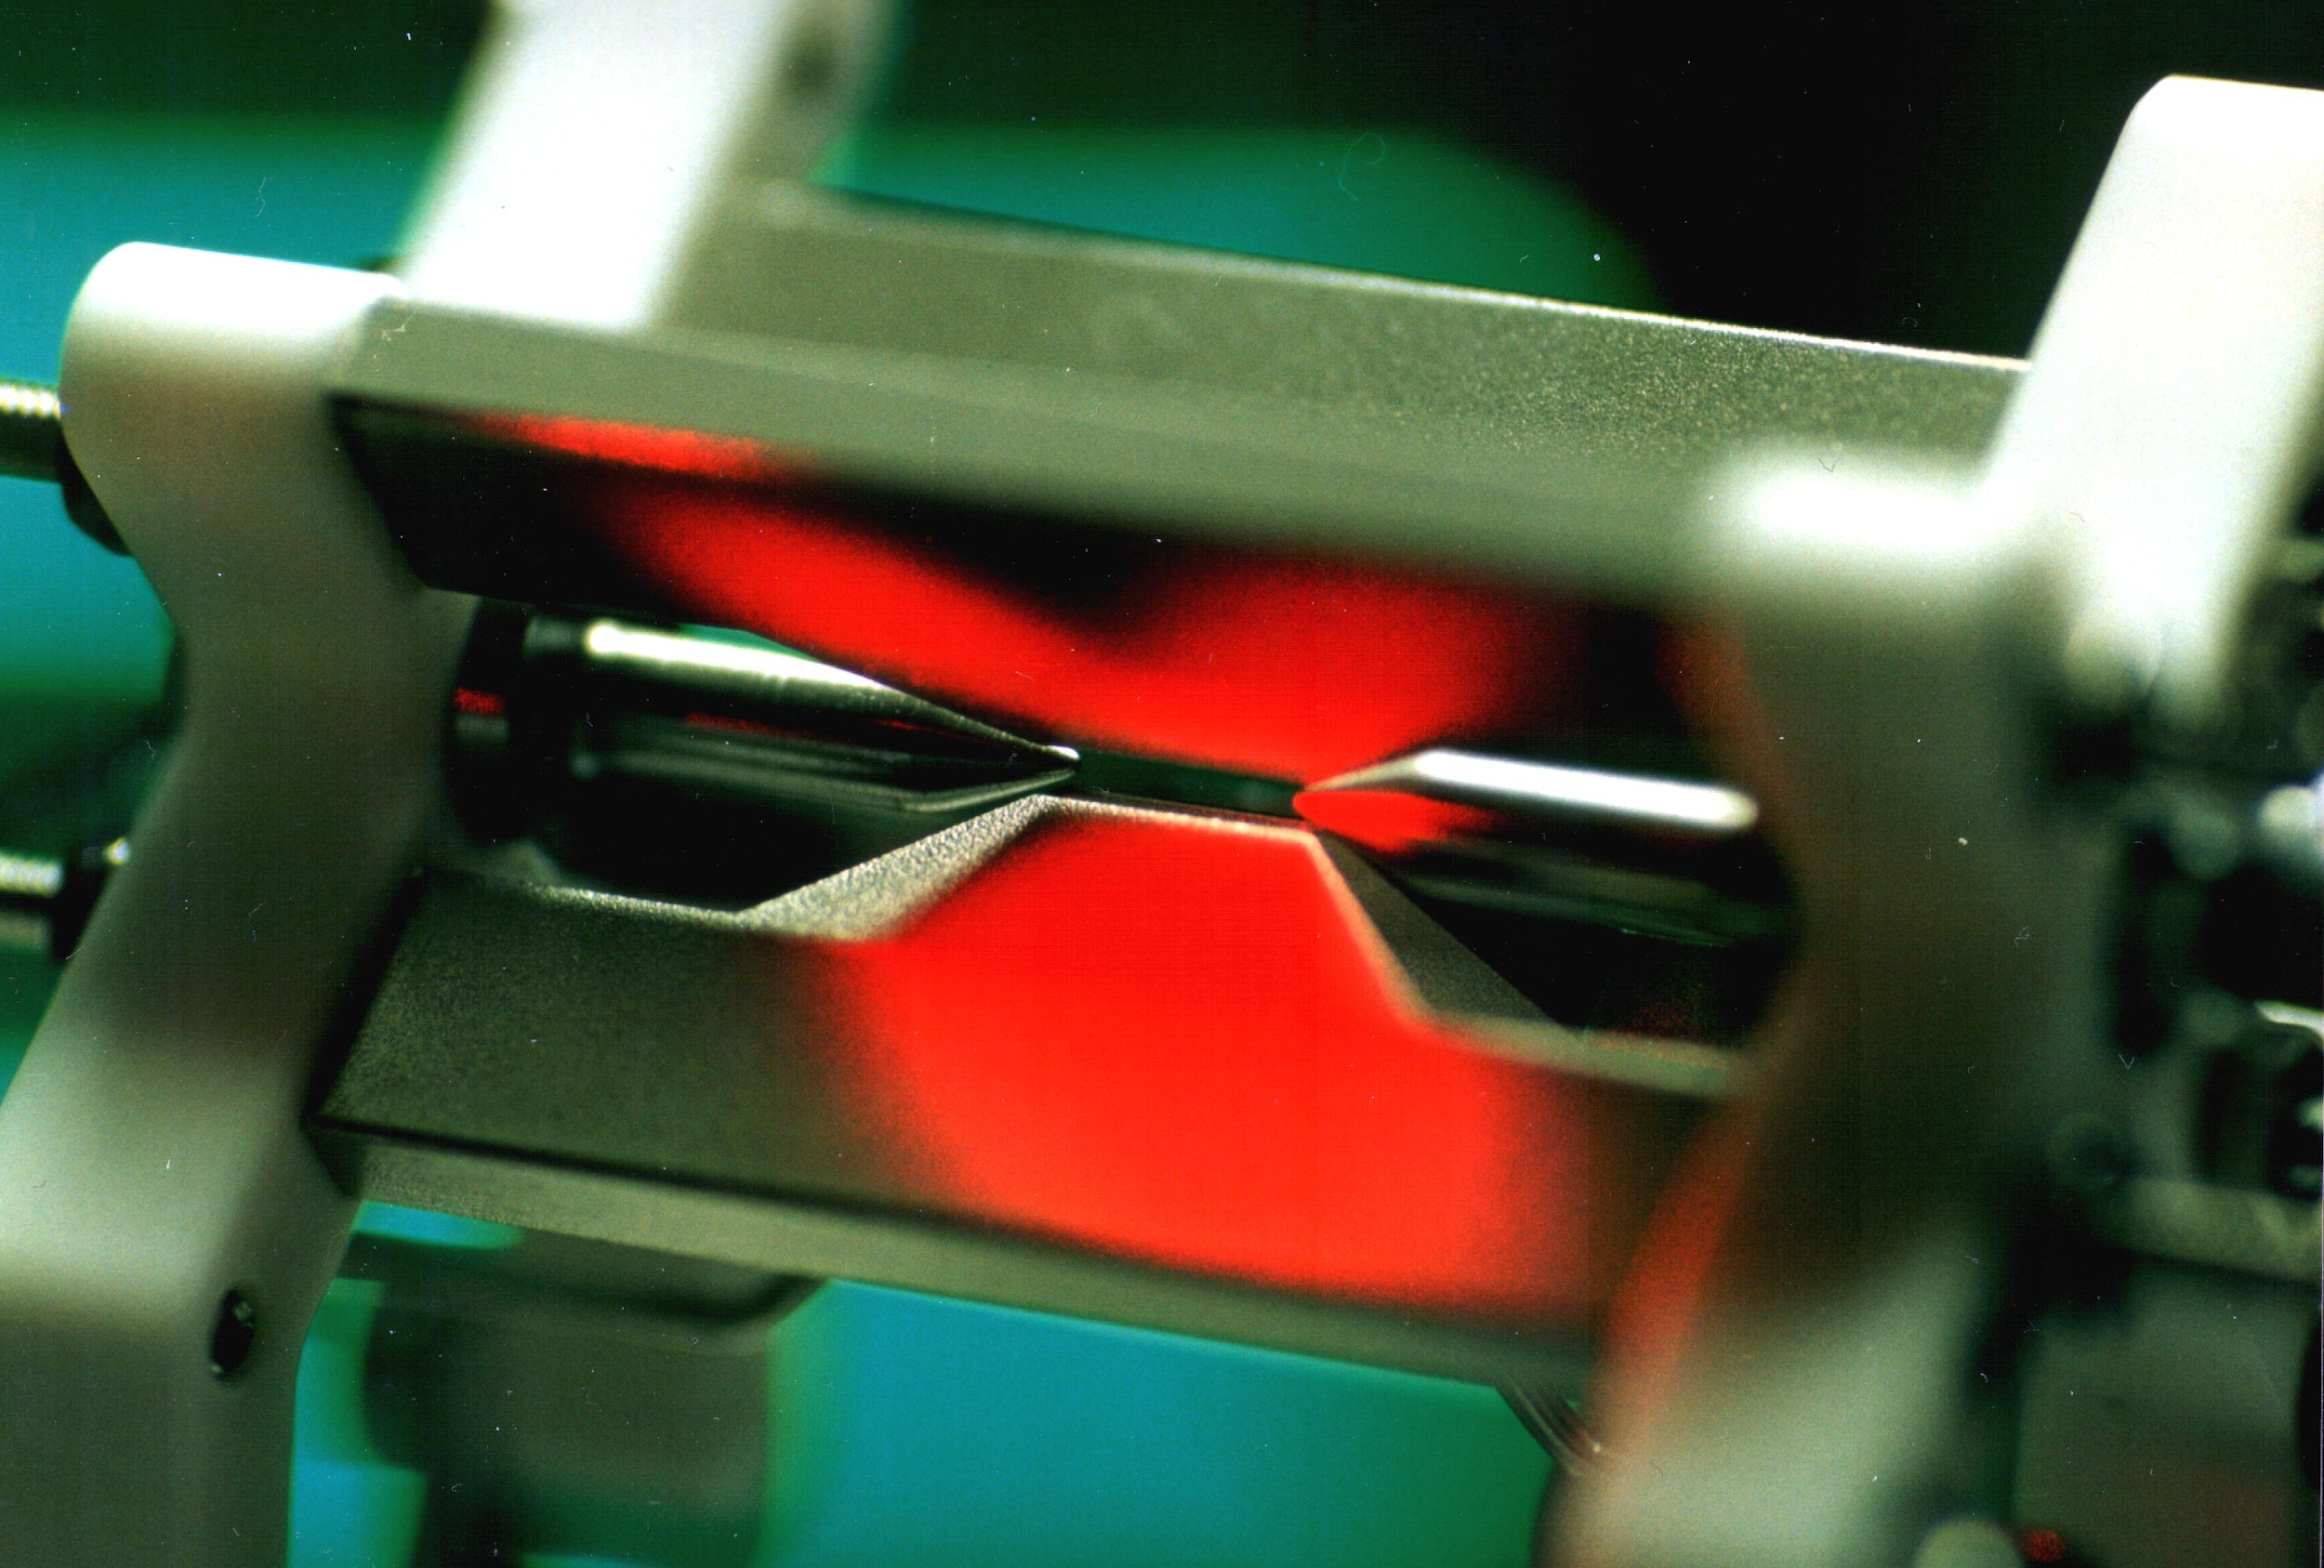

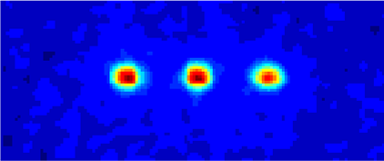
The Innsbruck ion trap quantum computer
Ca⁺
P
D
qubit
S
Notes:
‹#›
This ion crystal then develops normal modes of collective motion with center-of-mass frequencies on the order of 1 MHz. Here we see a parametrically excited mode

Slide 9
Motivation:
trapped electrons are the better ions
http://staq.pratt.duke.edu/
Good:
High fidelity operations, state-of-the-art errors rates of 10⁻³ - 10⁻⁶
Modular
Potonic interconnects, error rate 10⁻²
Flexible connectivity (see NIST, Honeywell)
Module sizes of 20 ions have been demonstrated (Innsbruck, U Maryland, IonQ)
Long coherence, up to 2 hours
Bad:
Optics development required
Slow operations (tens of microseconds)

Slide 10
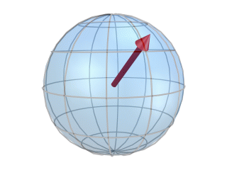
Motivation:
trapped electrons are the better ions
Electrons are simple and light:
Spin ½: ideal qubit
=> high-fidelity operation feasible
=> all-electronic control
Lightest charged particle
=> small mass speeds up operations

Slide 11
Idea: replace the ions in an
ion-trap quantum computer with electrons
Retain good features of the trapped ion approach while addressing its challenges.

Slide 12
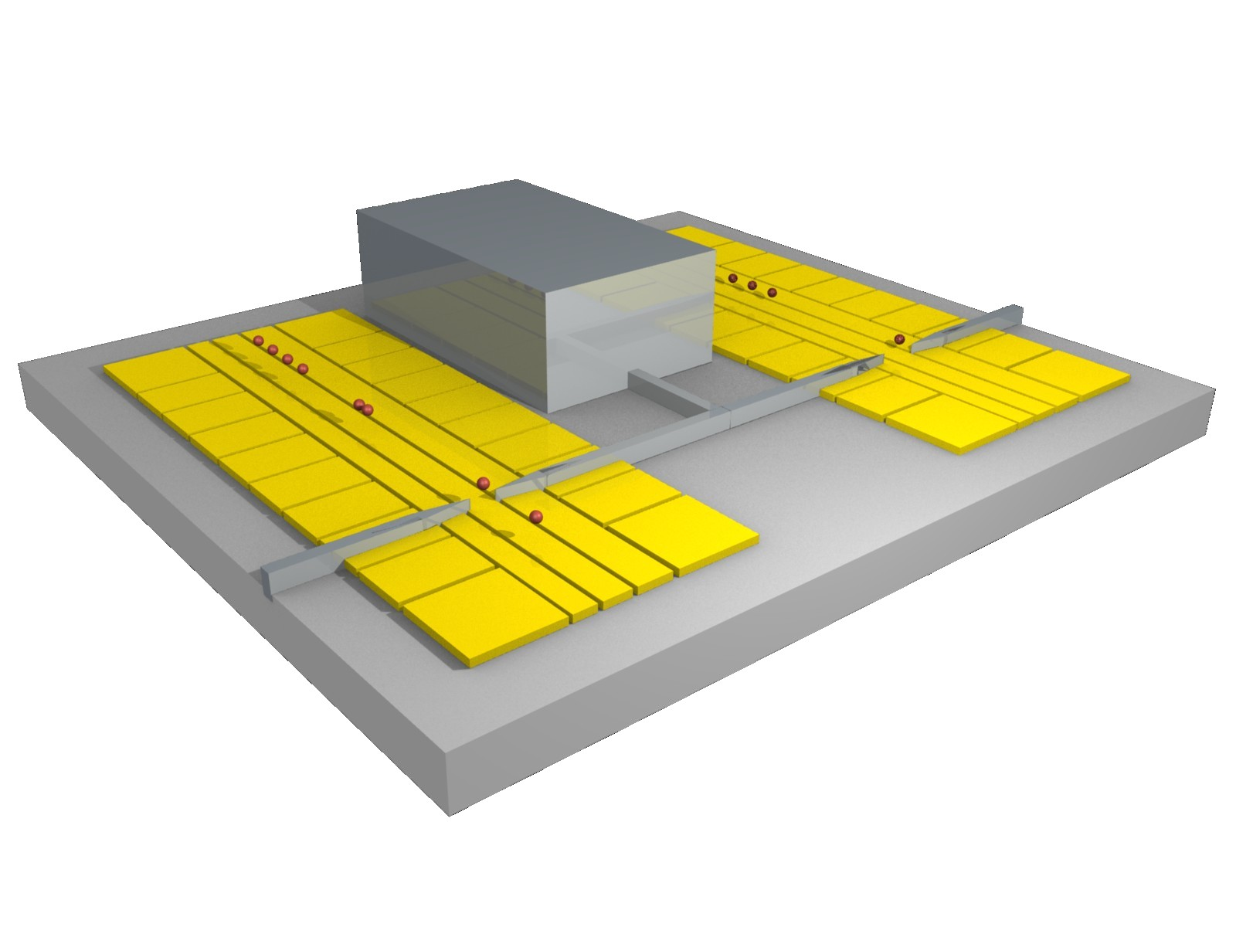
Vision: an electron quantum computer
Expected features:
- All electronic operation
- Gate speed: 10 - 100 ns
- Coherence time: >1 s
- Temperature: 0.1-4 K
Advantages over ions:
- no lasers, no optics
- easy interface to circuit based QIP
- 10² - 10³ times faster
Advantages over superconducting qubits:
- less stringent cooling requirements
- much improved coherence times
- higher connectivity
Catch: nobody has tried trapping electrons in a Paul trap yet.

Slide 13
From ions to electrons
Ion qubits
Optical frequencies (lasers, optics, electrooptics)
rf (20-40 MHz)
Room temperature (300 K)
Electron qubits
Microwave frequencies (GHz electronics …)
μw (10-20 GHz)
Cryogenic (1 K)
?
~ USD 10⁶ + a few years
Trapped electrons
1-2 GHz
Room temperature
~ USD 10⁵ + one year?

Slide 14
Trapping electrons
Electron trap
Electron source
Electron detector
What do we need?

Slide 15
Electron trap: basic considerations
~
~

Slide 16
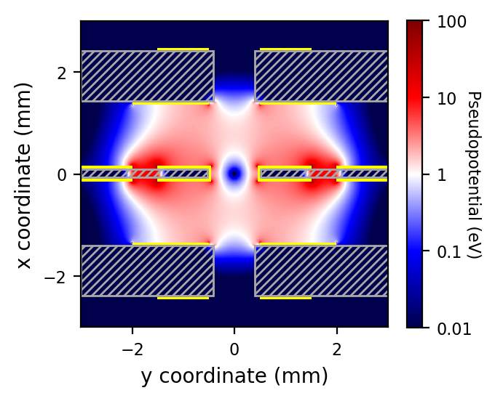
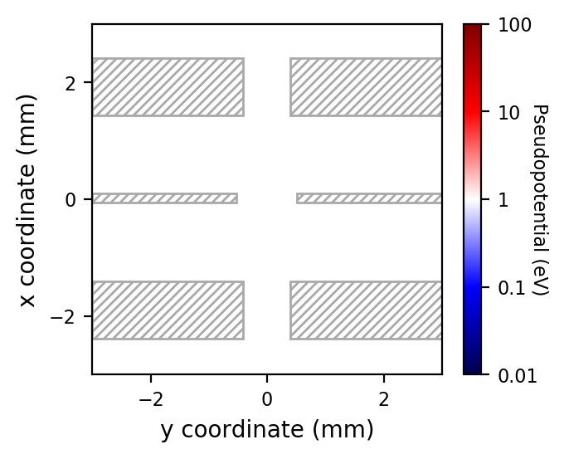
Electron trap: Design based on PCB
Design considerations
Good μw properties: RO4003C substrate
Thickness (1, 0.2, 1) mm
Distance 1.27 mm
Slots (0.8, 1, 0.8) mm
Smallest features ~ 150 μm
Simulate trapping potential
90 V @ 1.6 GHz

Slide 17
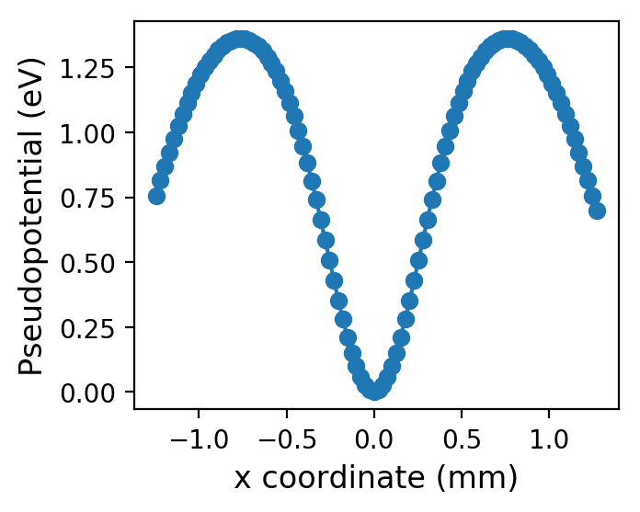
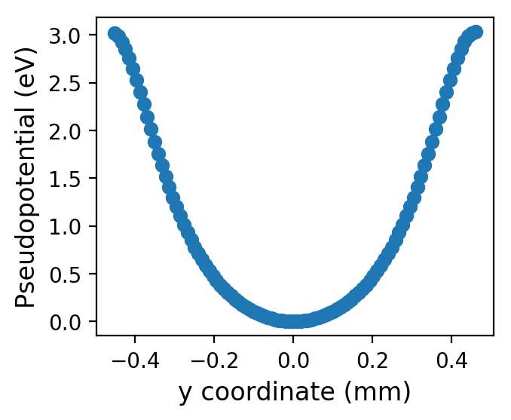
Electron trap: Design based on PCB
1.3 eV → 15,000 K

Slide 18
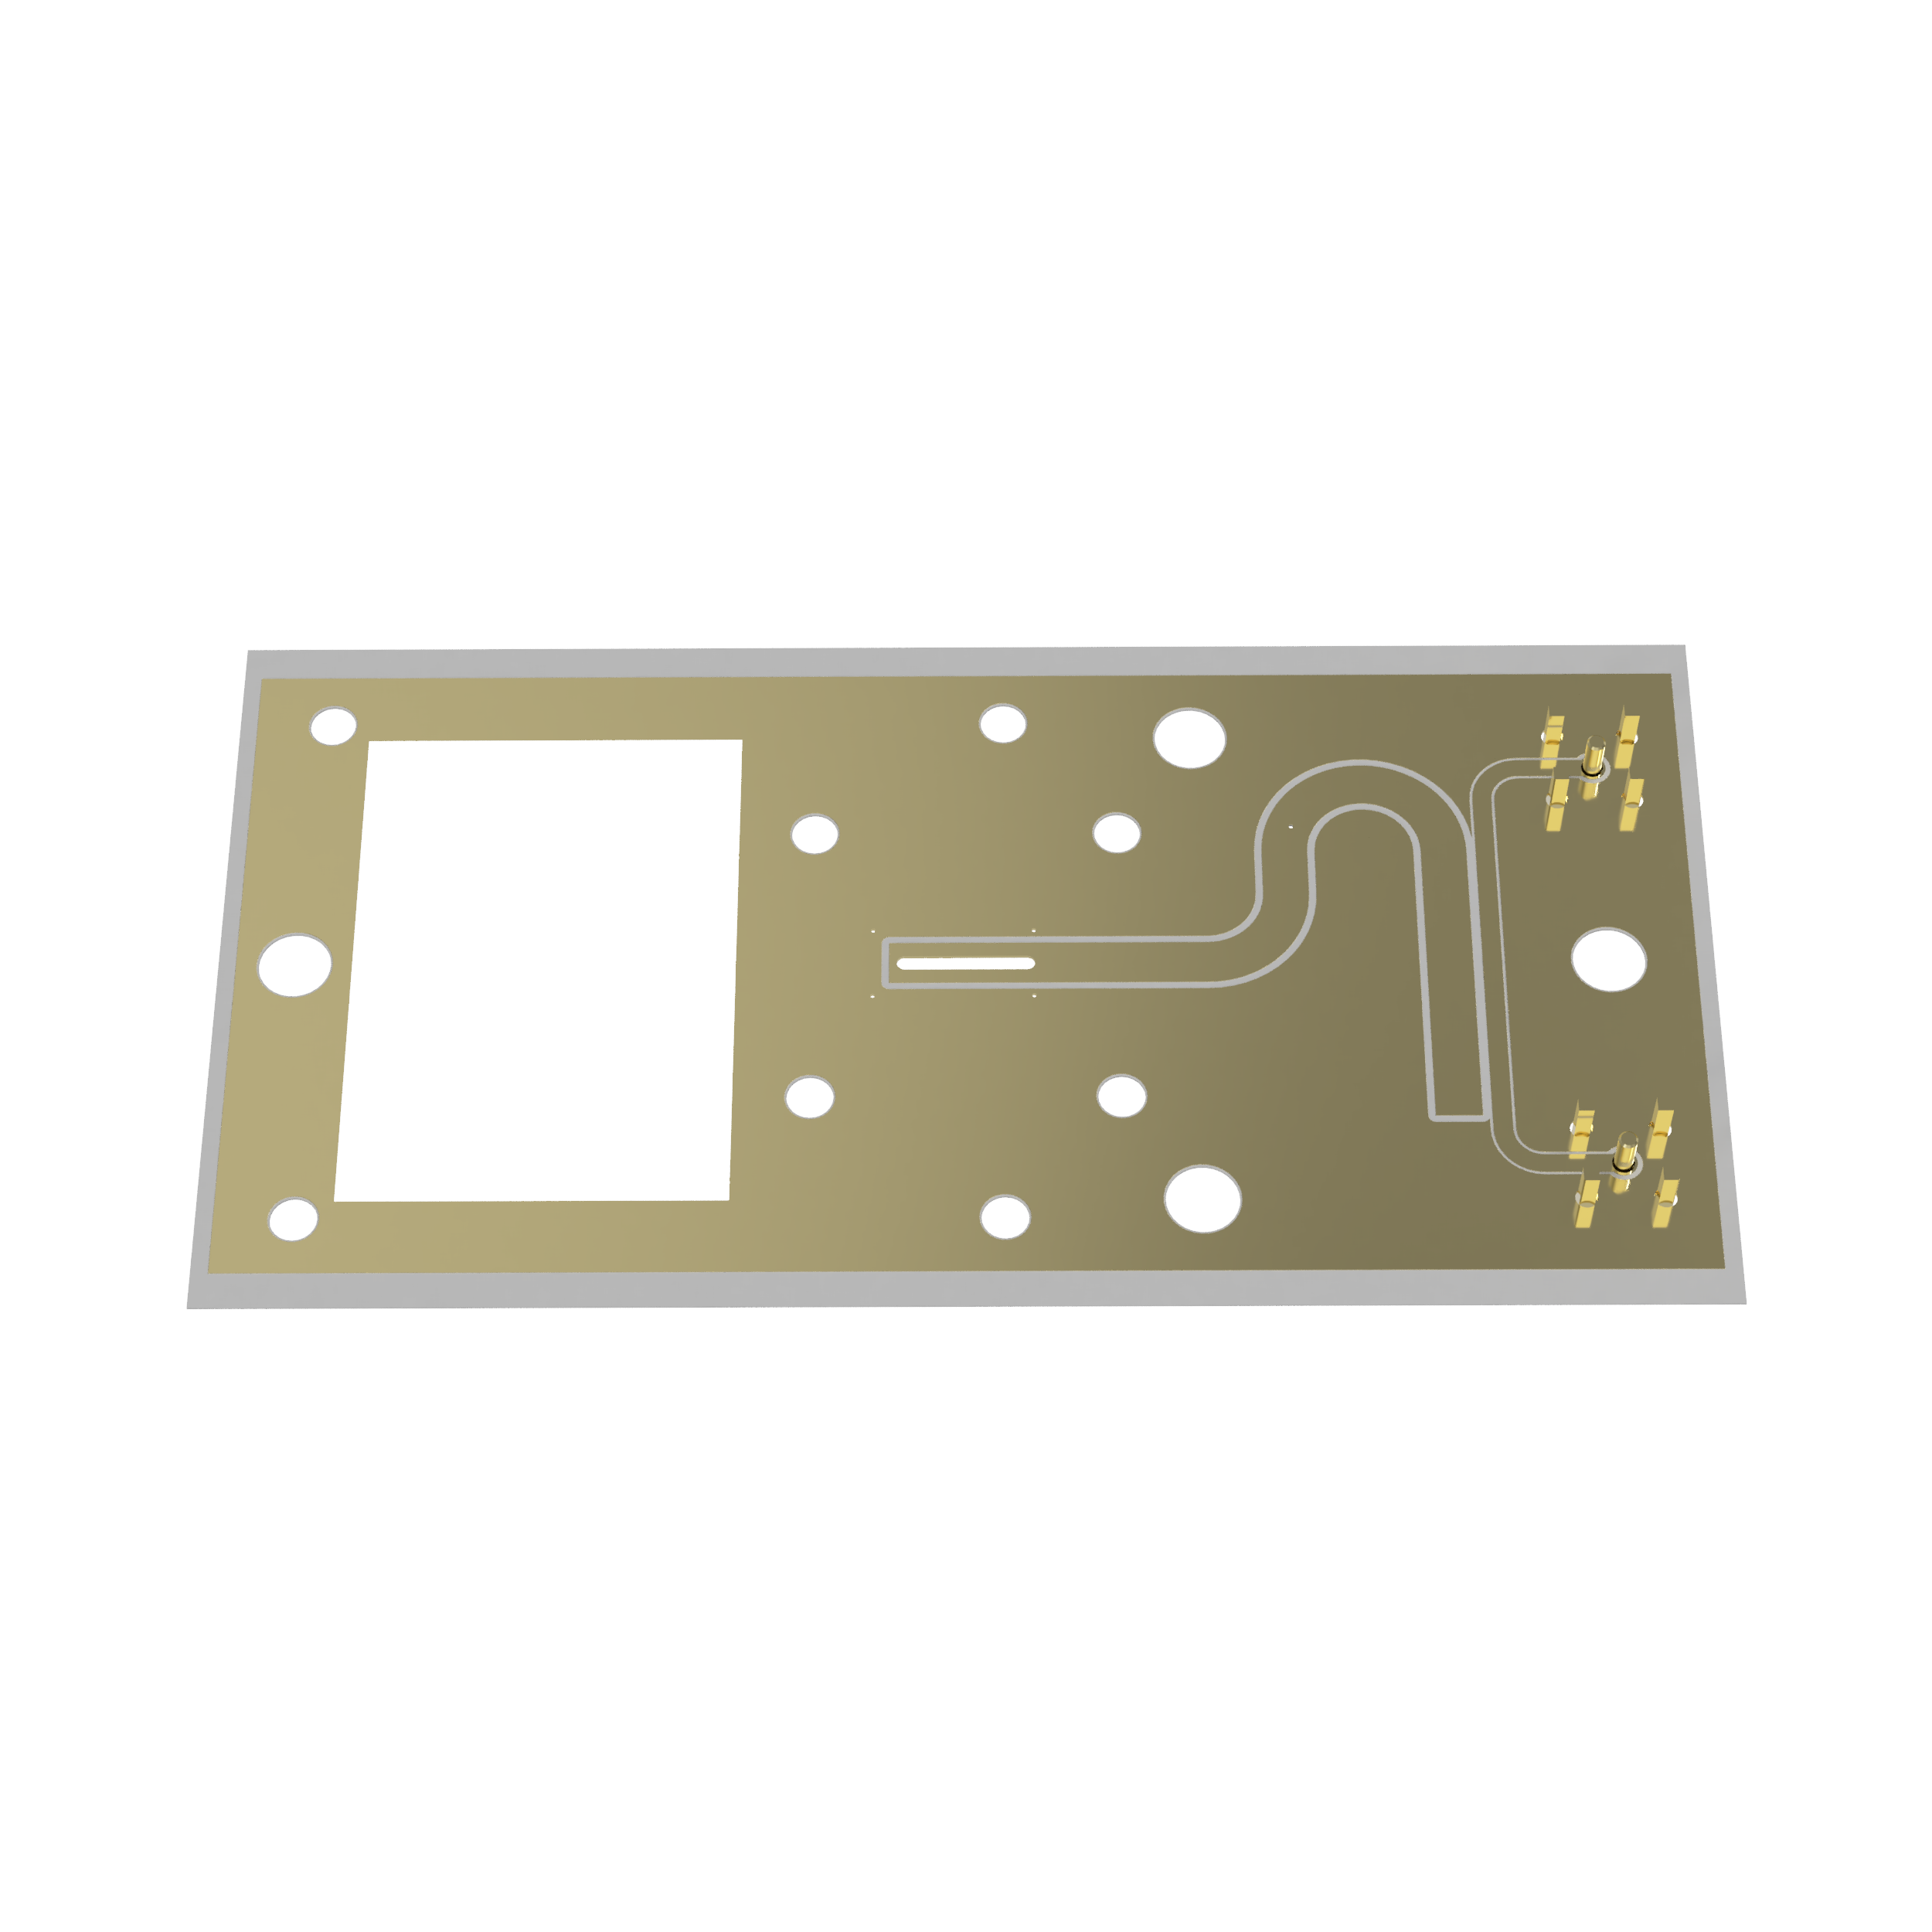
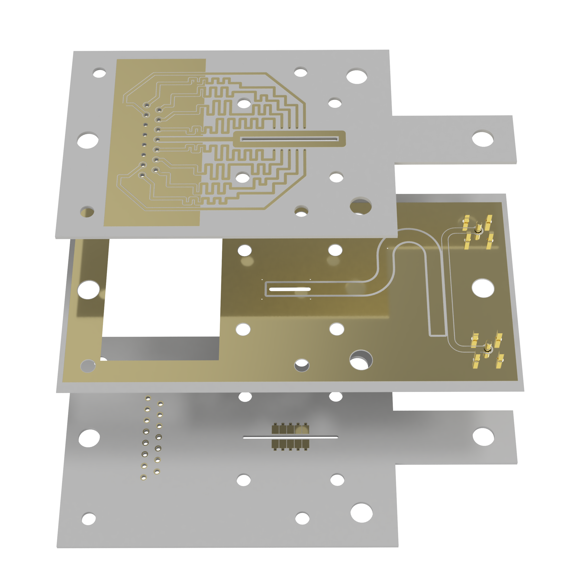
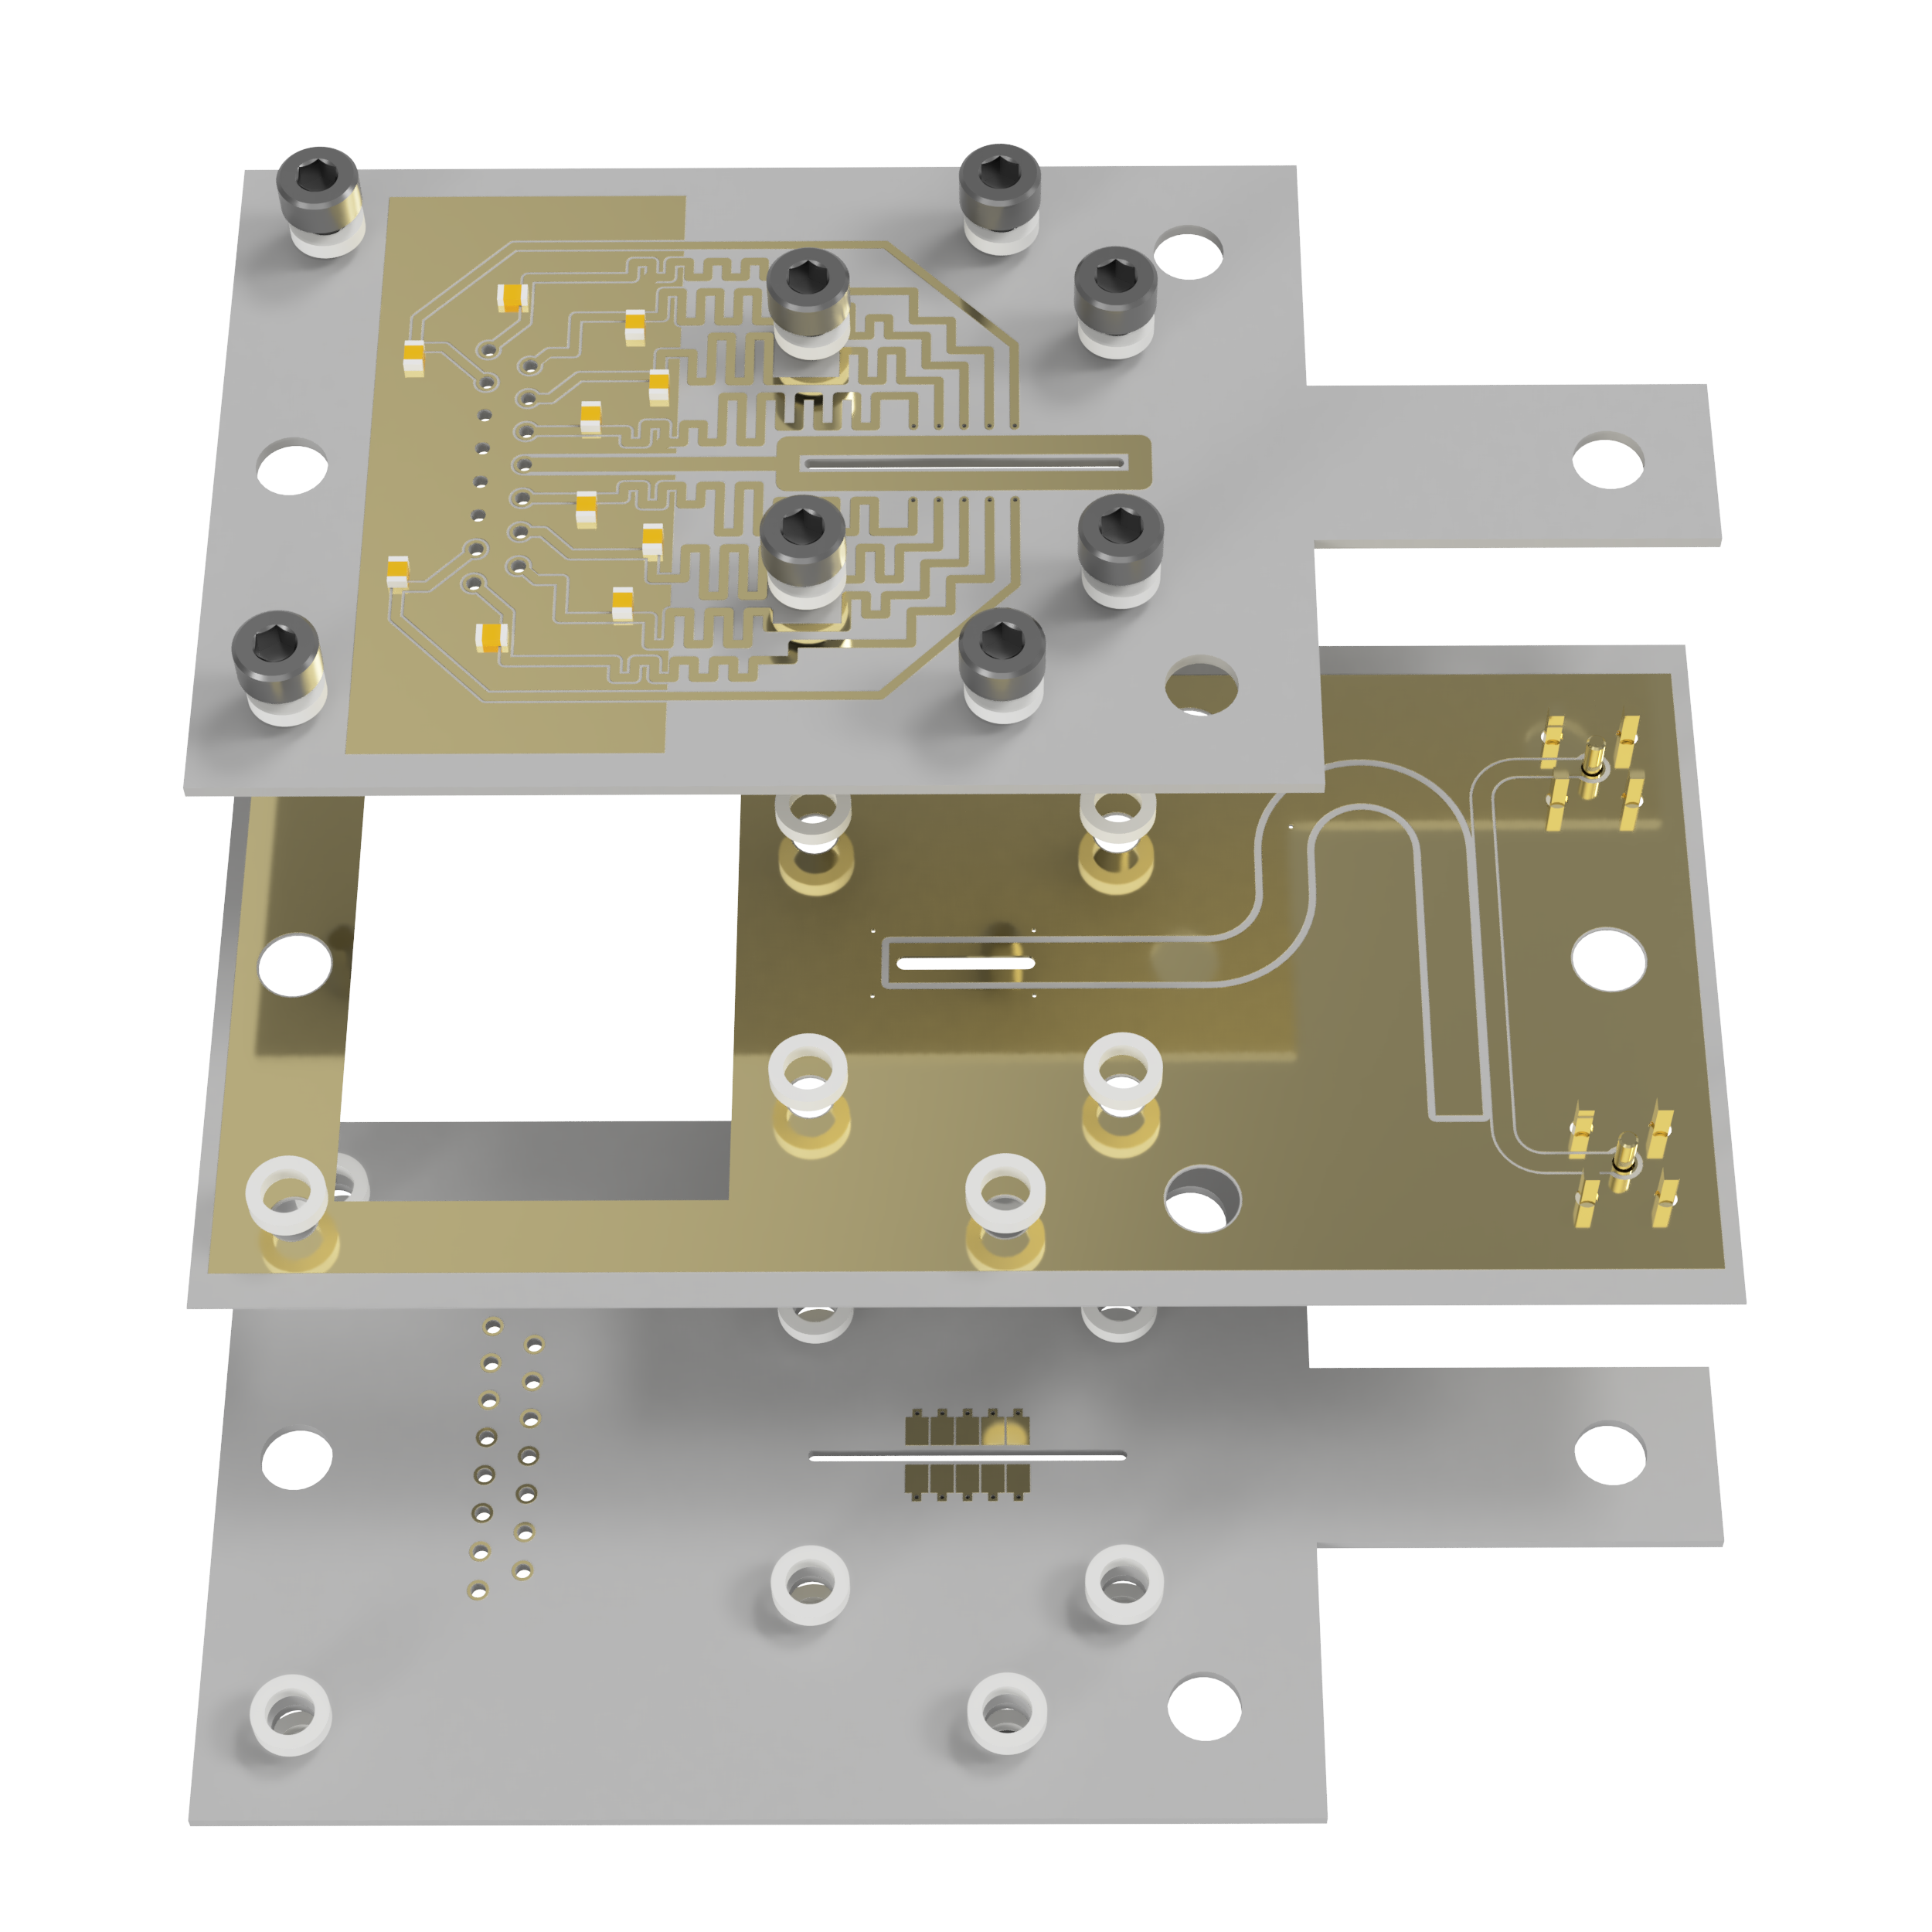
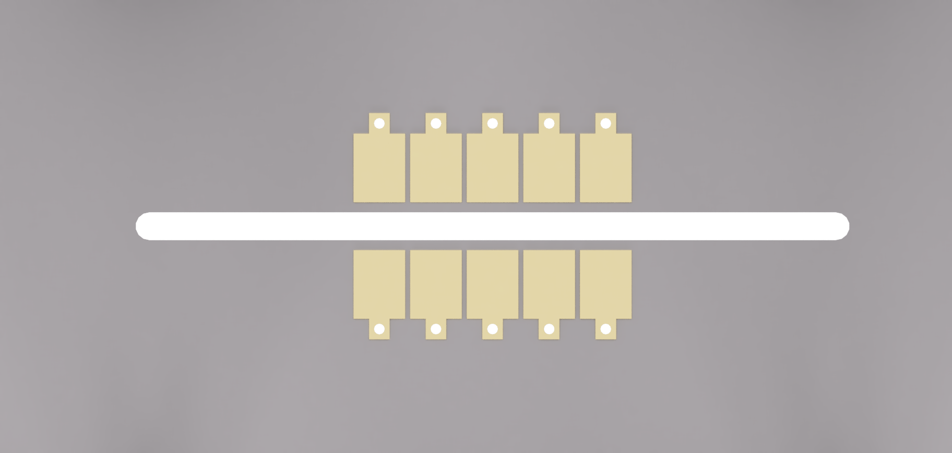

Electron trap: Board layout

Slide 19
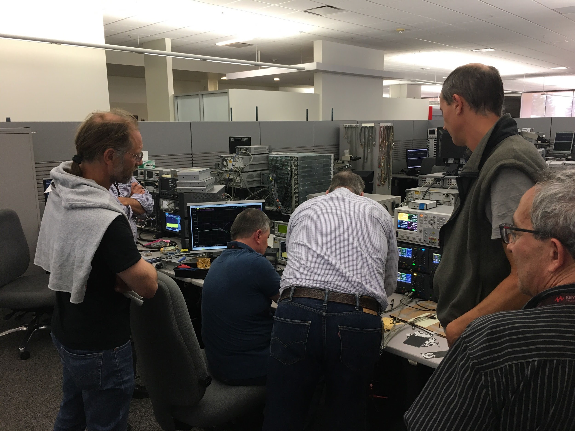
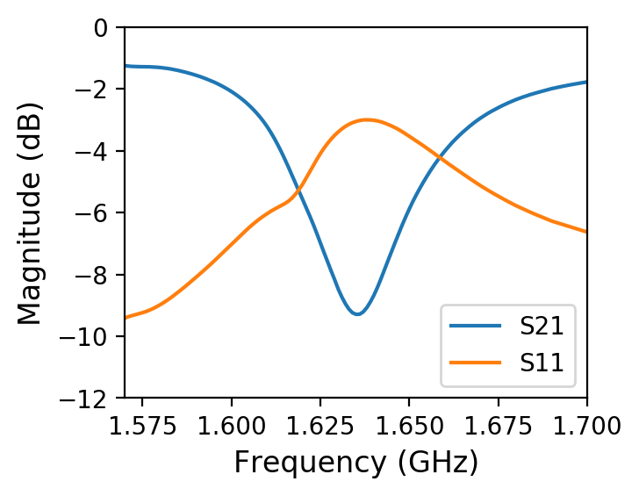
Electron trap: resonator
Measurement: Miroslaw Adamski et al. (Keysight)

Slide 20
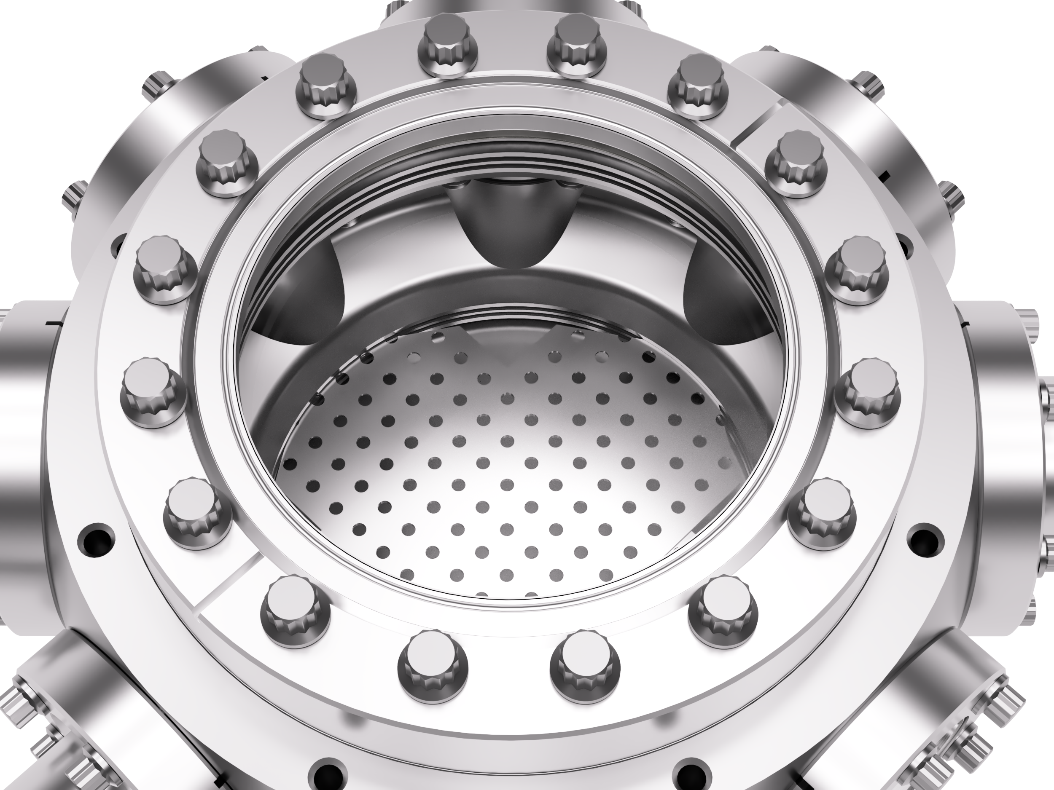
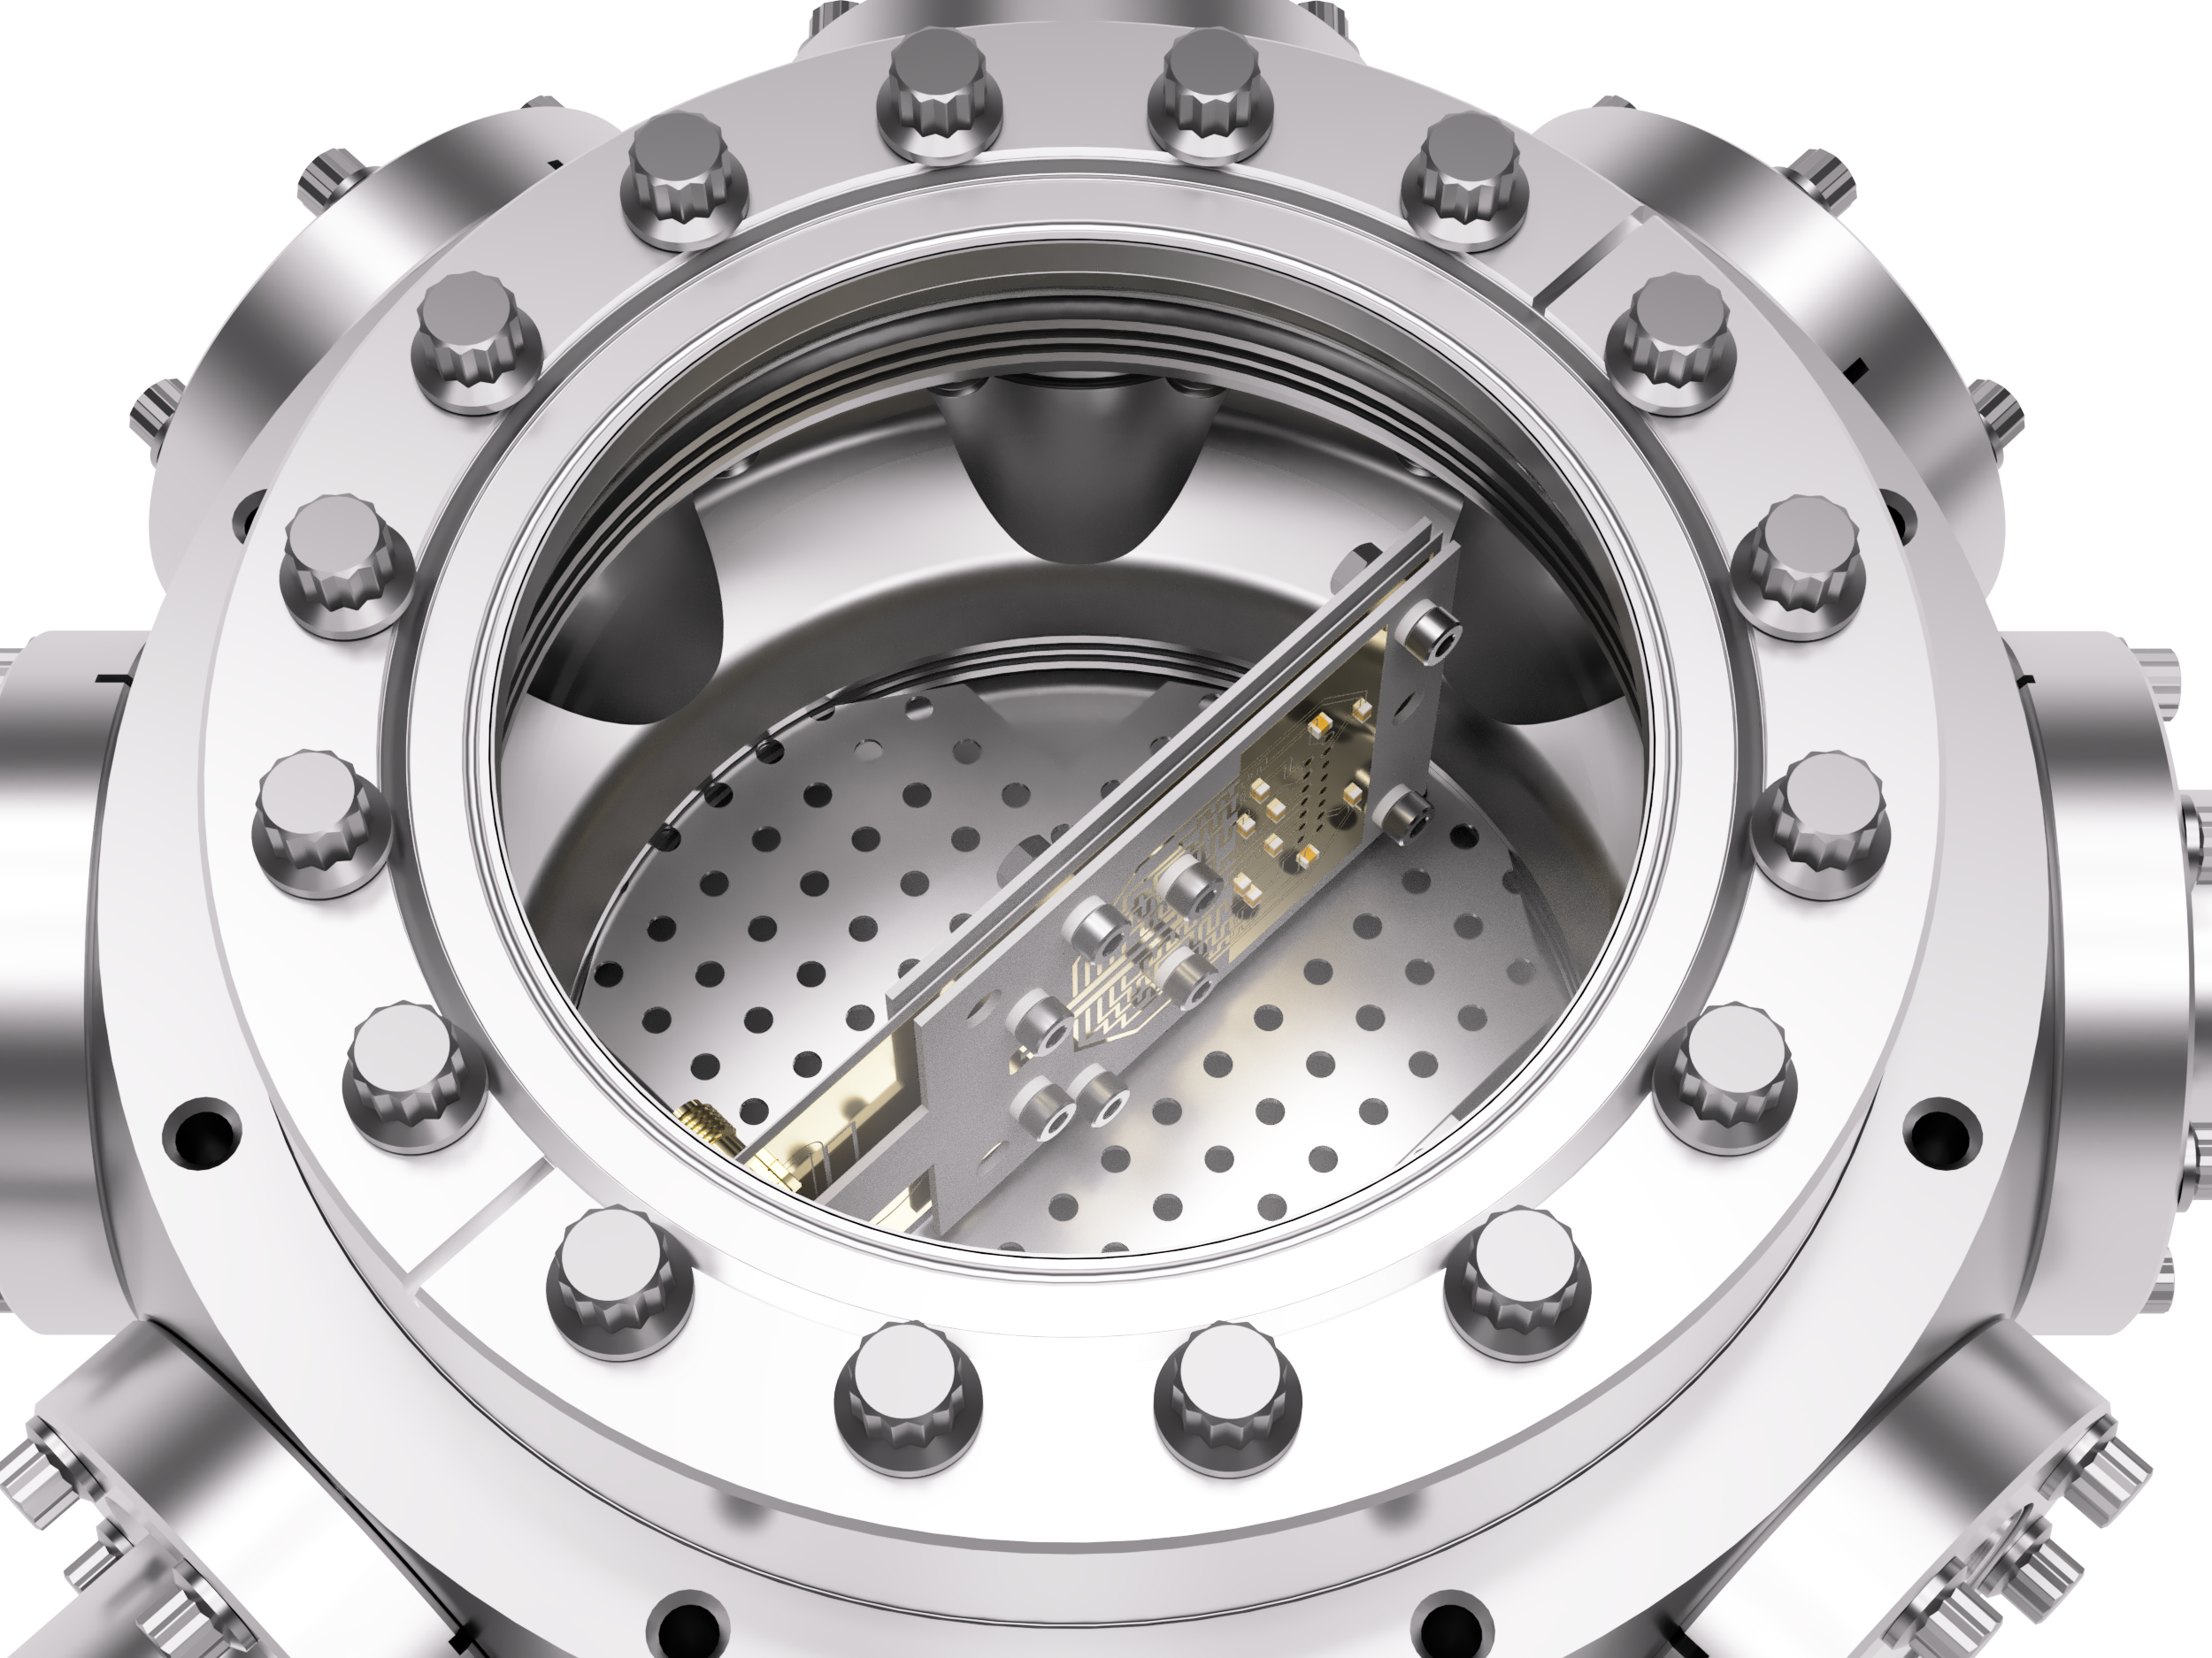
Setting up the experiment
Ultra-high vacuum chamber:
< 10⁻¹⁰ mbar (atmosphere ~ 1000 mbar)
Elements for trap:
μw source, 5 W amplifier, circulator + power meters, 25-channel DAC

Slide 21
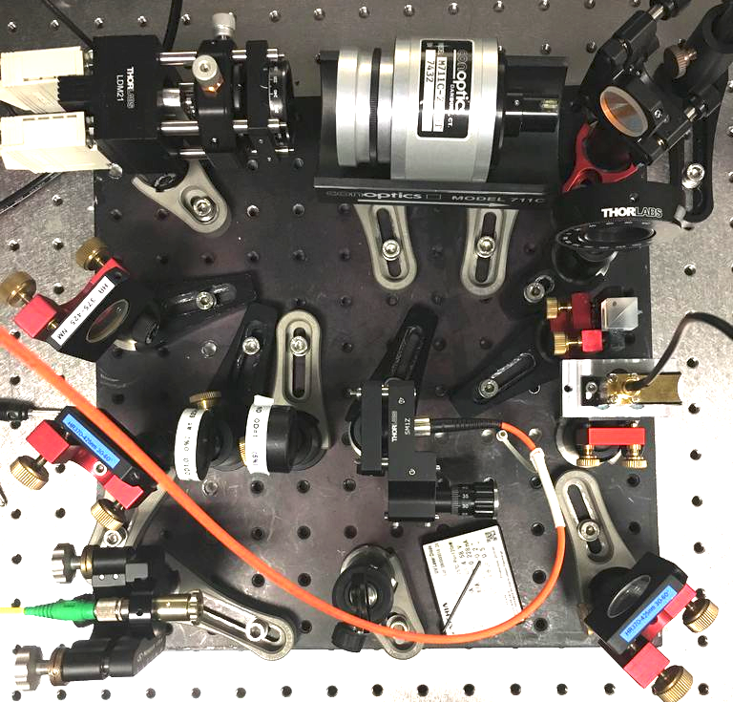
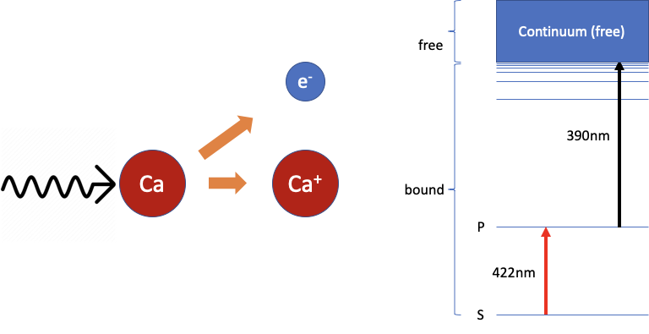
Electron source
Electrons need to
Have low kinetic energy
Be inserted into the trap
Energy
Photoionisation!

Slide 22

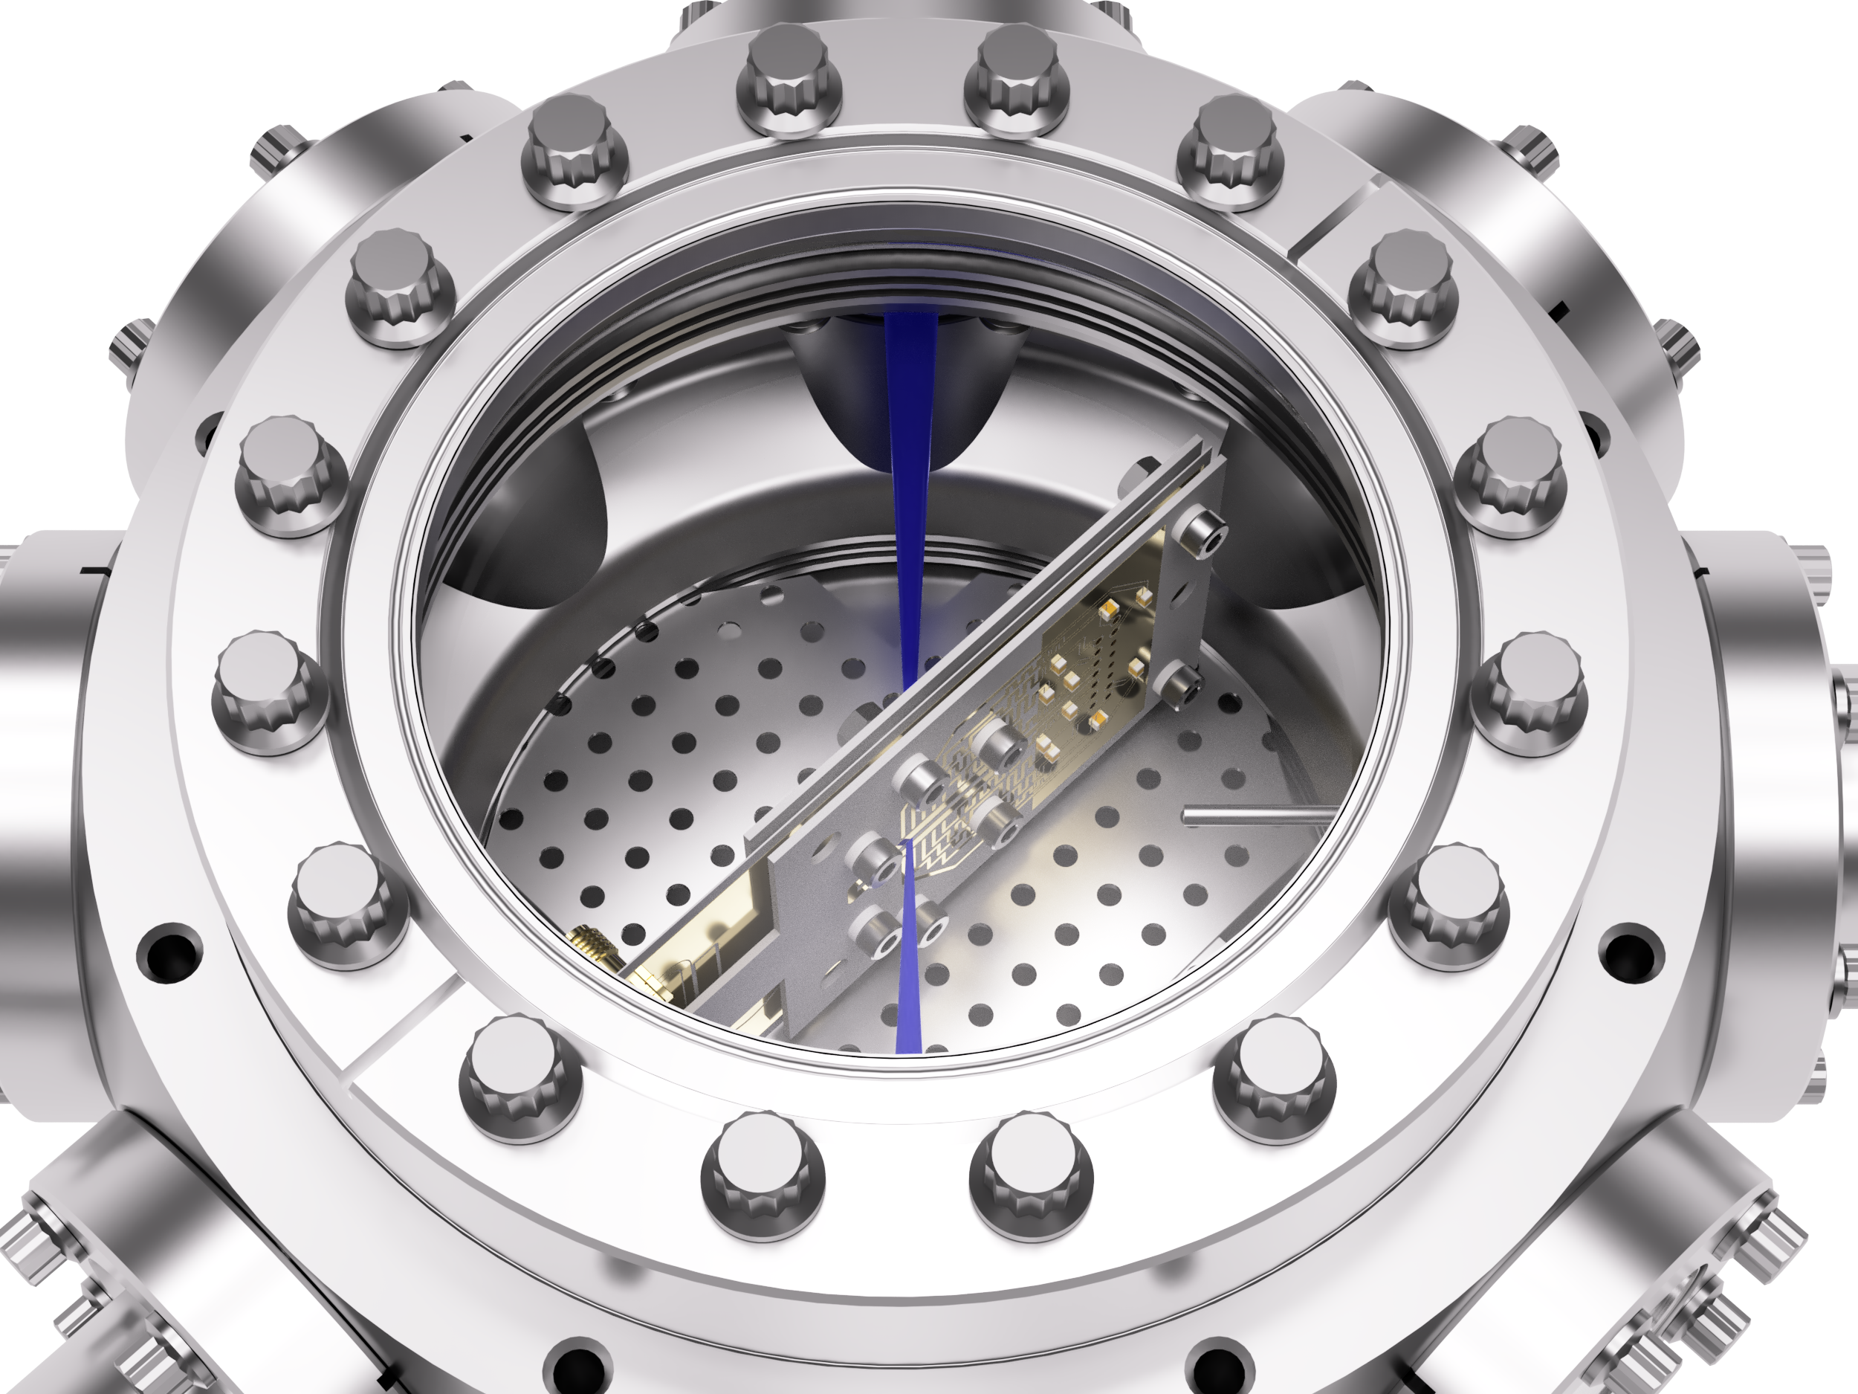
Setting up the experiment
Elements for photo- ionisation:
Ca oven, current source, 2 lasers

Slide 23
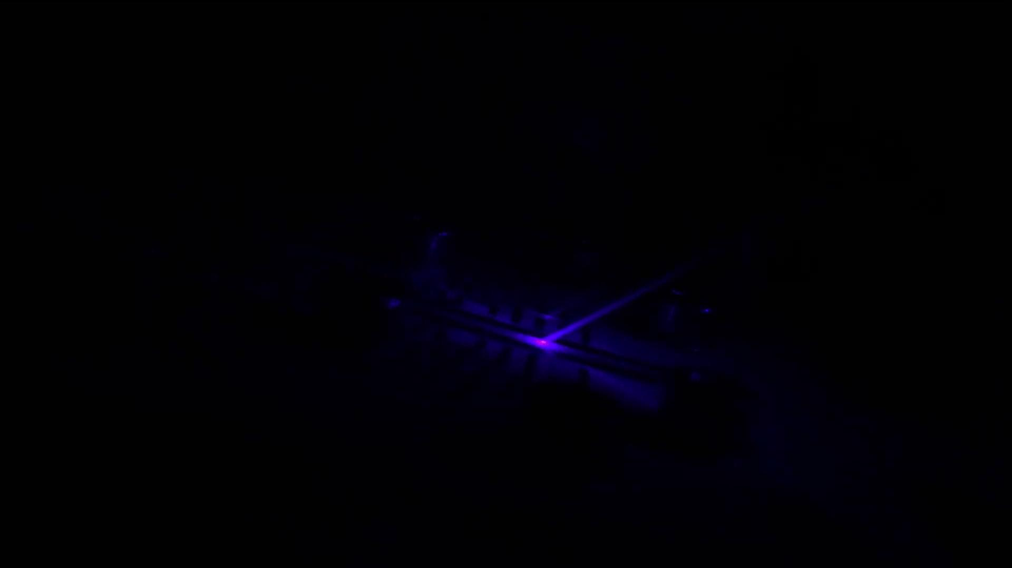

Slide 24
Electron detection
Modify potential to extract trapped charges
Apply +14 V pulse
Apply +10 V pulse

Slide 25
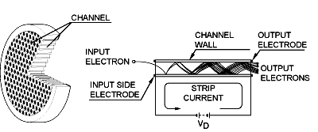
Electron detection
2500 V
2200 V
200 V
150 V
14 V
Microchannel plate (MCP)
Mesh
trap
http://www.dmphotonics.com/MCP_MCPImageIntensifiers/Image27.gif

Slide 26
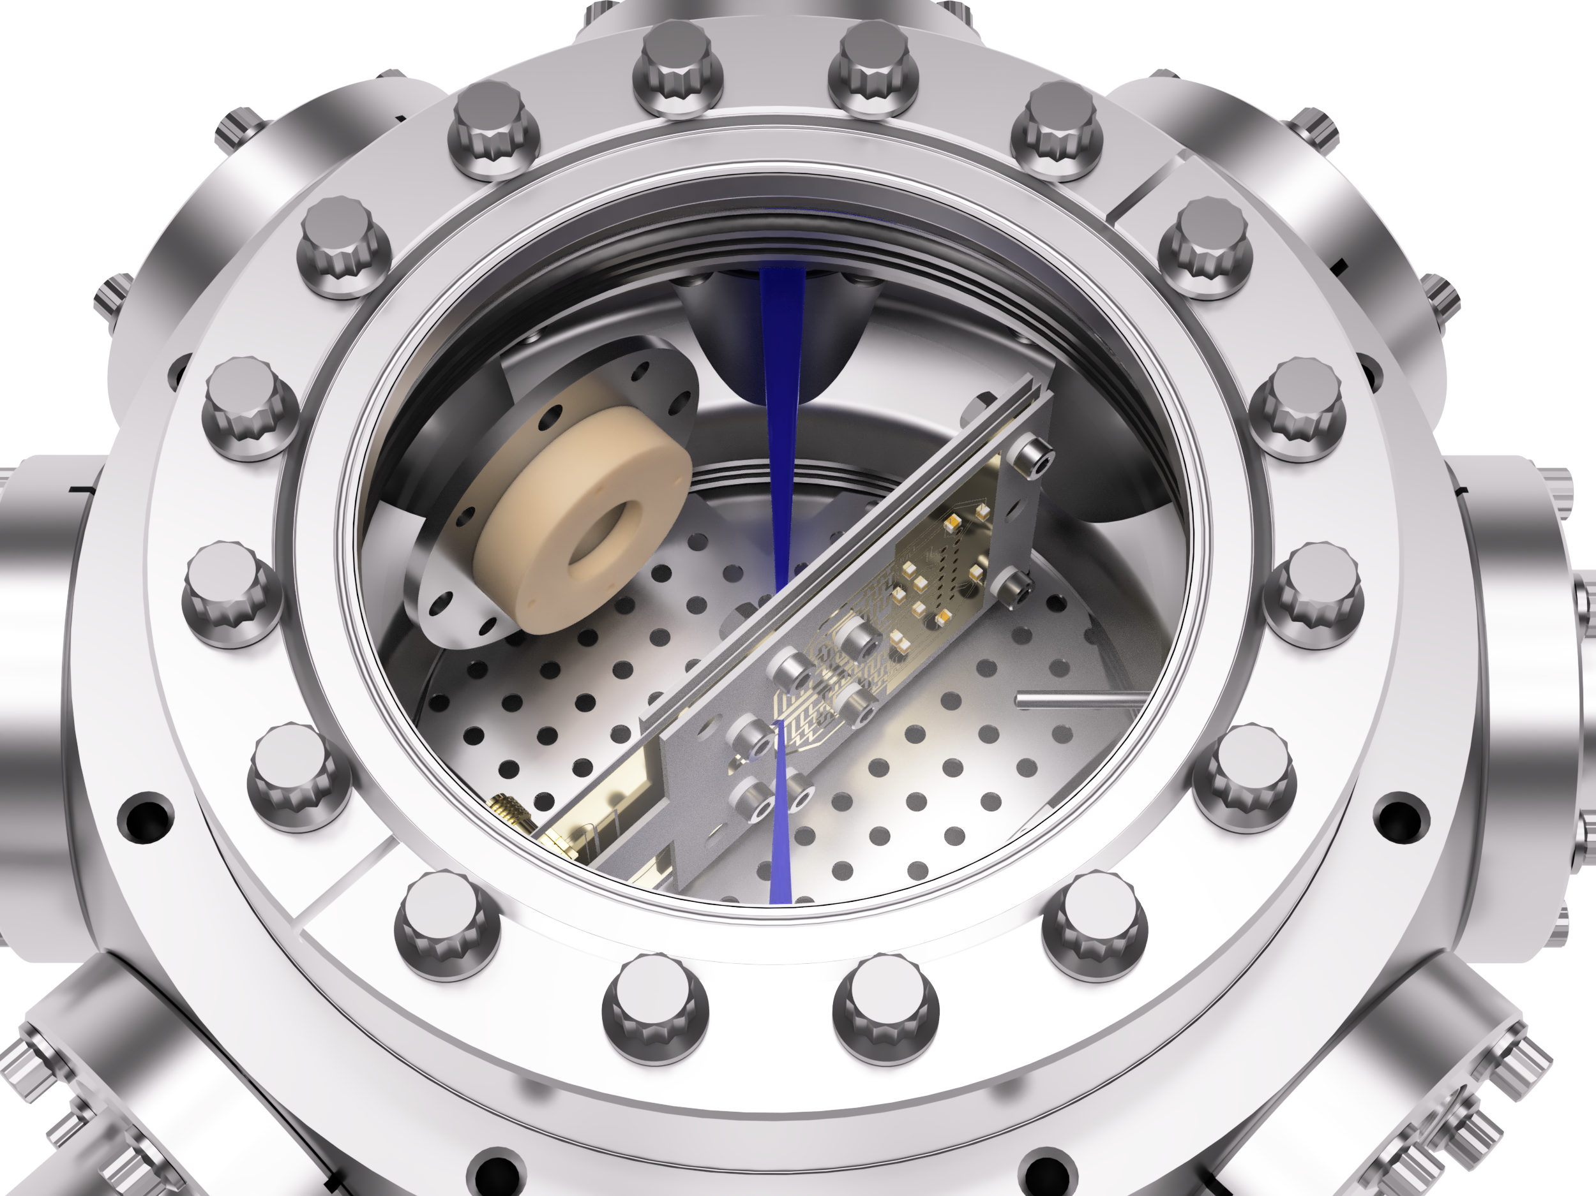

Setting up the experiment
Elements for electron detection:
MCP, mesh, 4 x HV sources, pulse shaping electronics

Slide 27
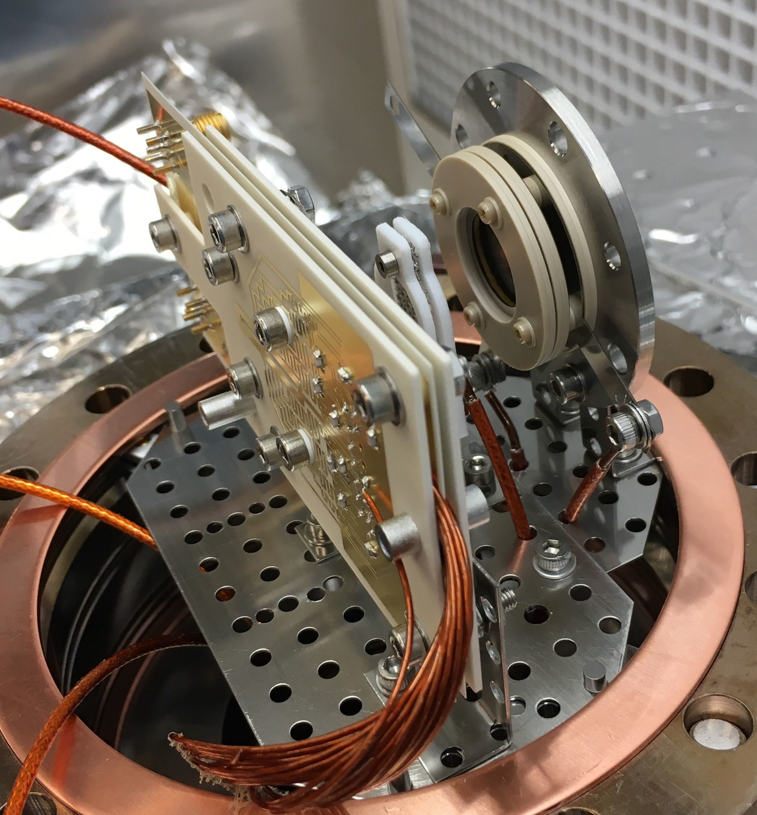
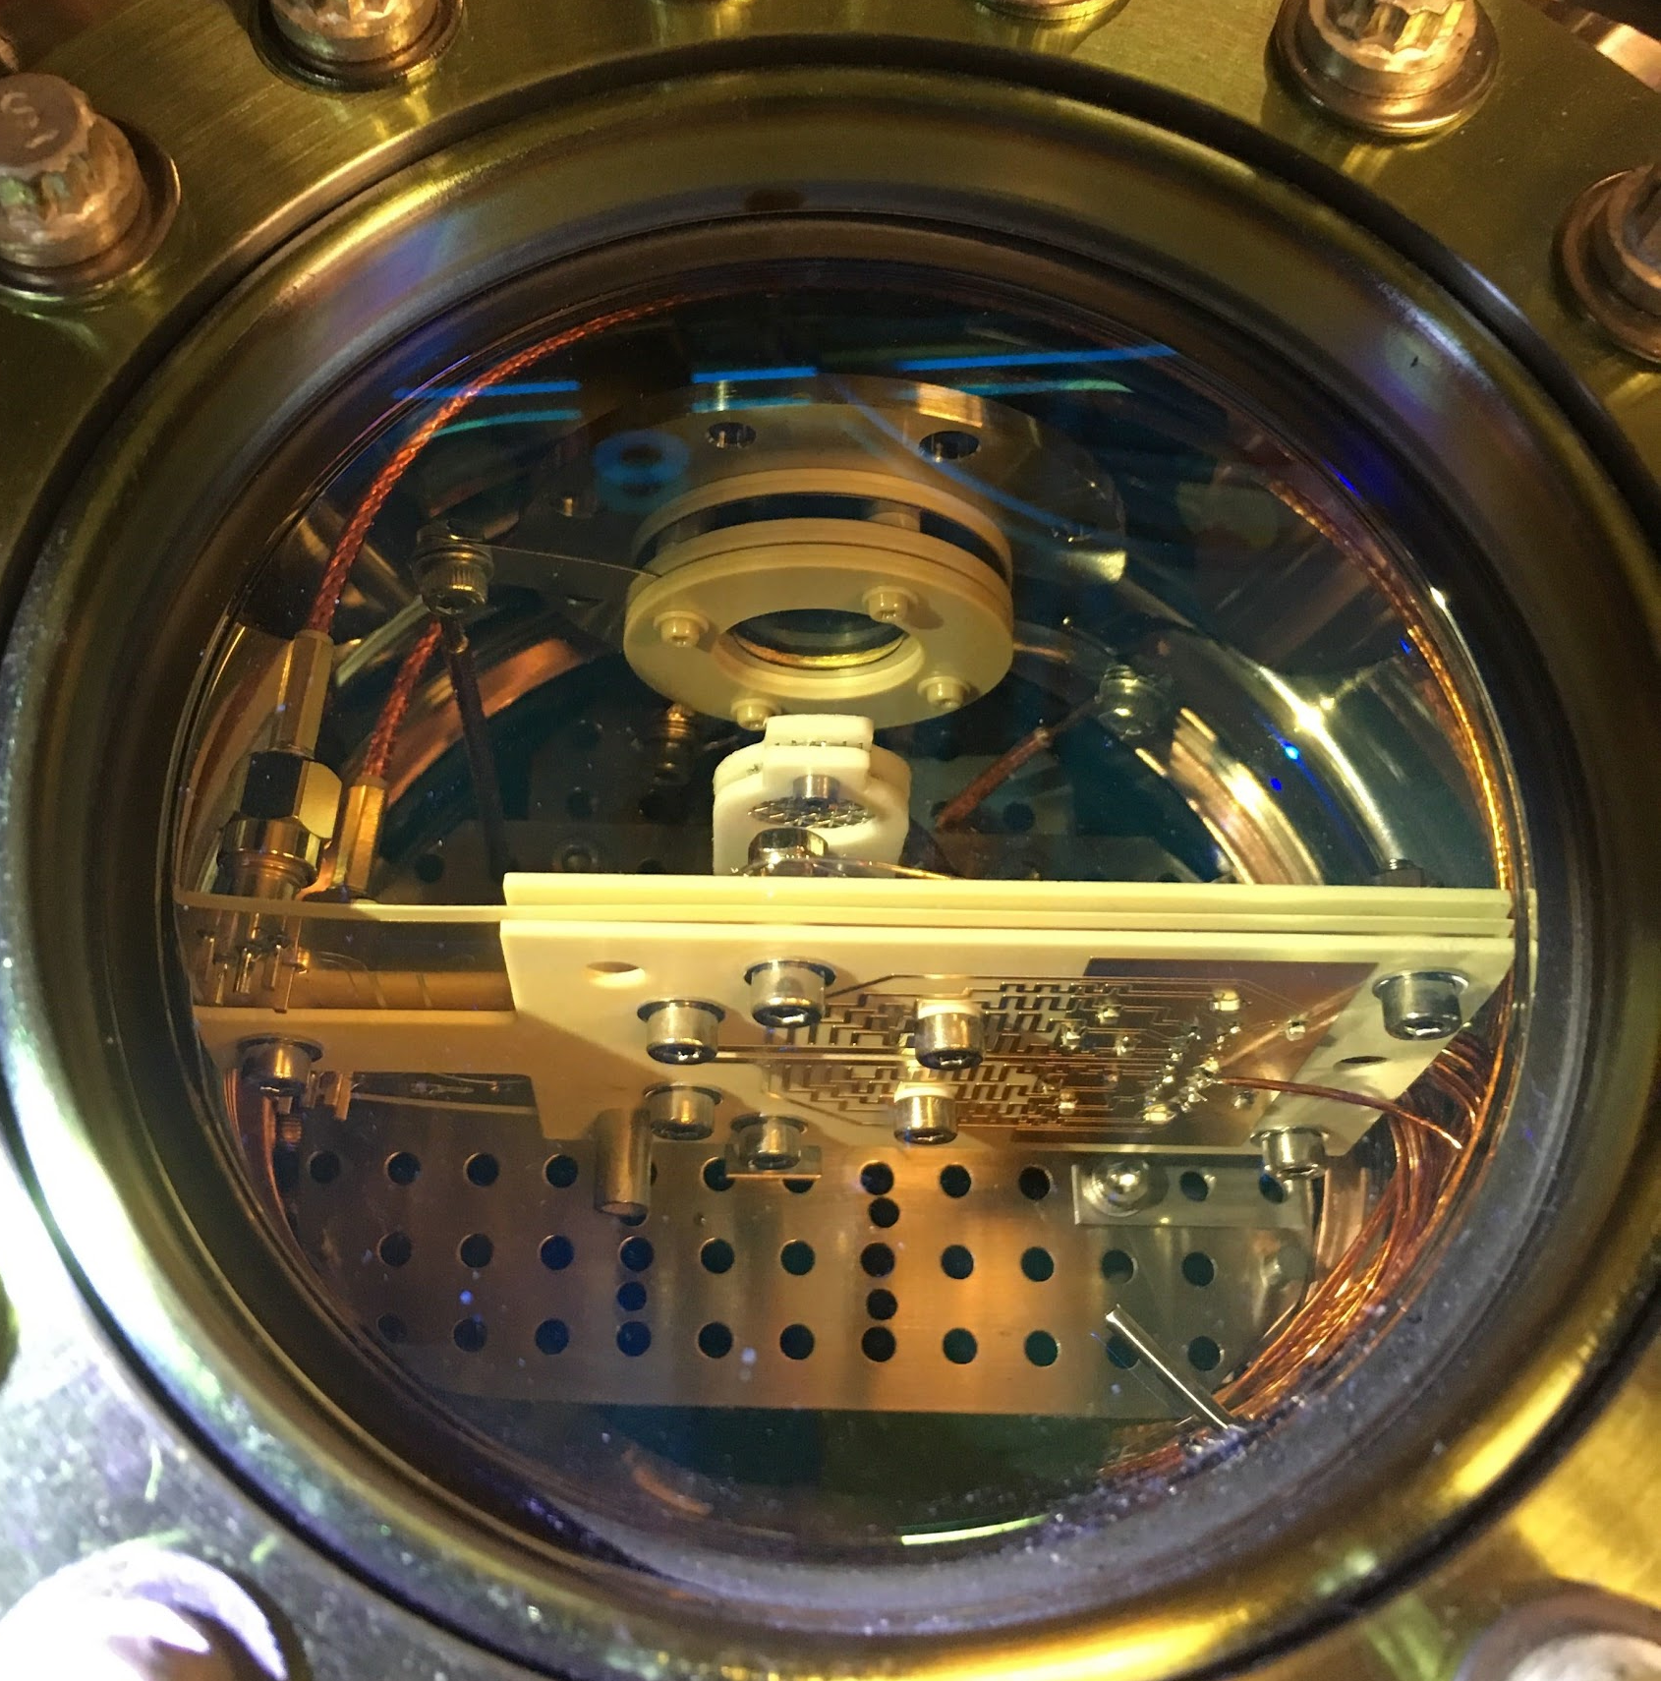

Slide 28
Trapping electrons
Design experiment
Find flaws
Improve experiment
Try again
How do we do it?

Slide 29
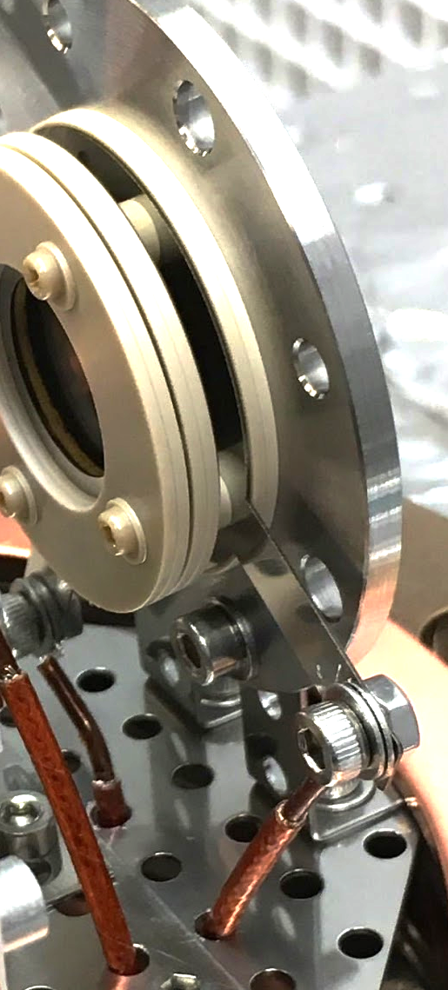
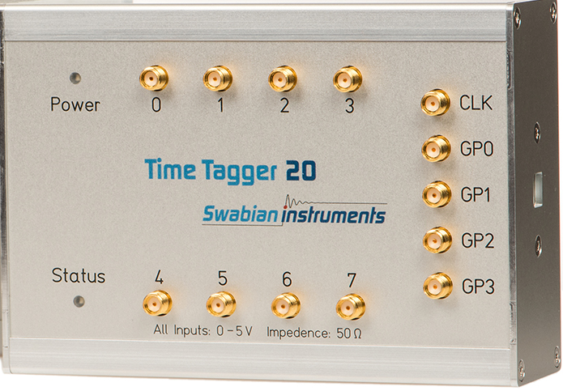
The basic idea
Record correlations between electron detections and the extraction pulse
Use time tagger (TDC) to record arrival time of pulses from microchannel plate
detection??

Slide 30
The basic idea
AWG
start pulse
extraction pulse
DAC
390 nm
422 nm
e⁻
time tagger
PI lasers
Trap
MCP
stop pulse
Ca
oven

Slide 31
In more detail...
Stack of two microchannel plates
200 V
2200 V
Anode
2500 V
Electron avalanche during detection creates ripple on supply voltage
detection??

Slide 32
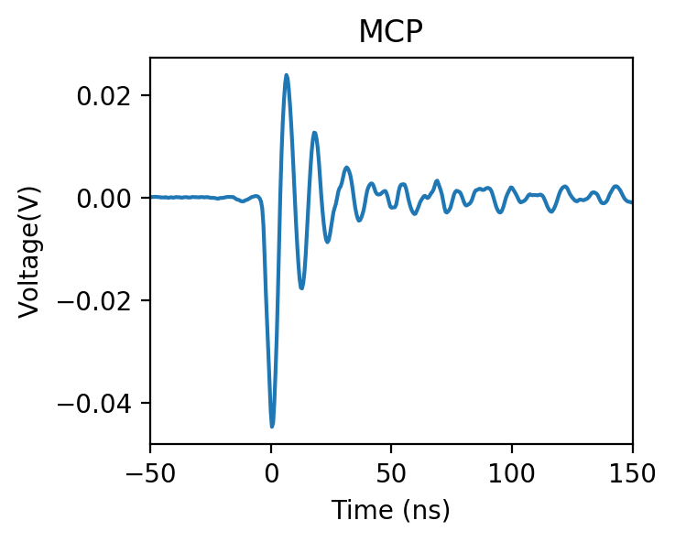
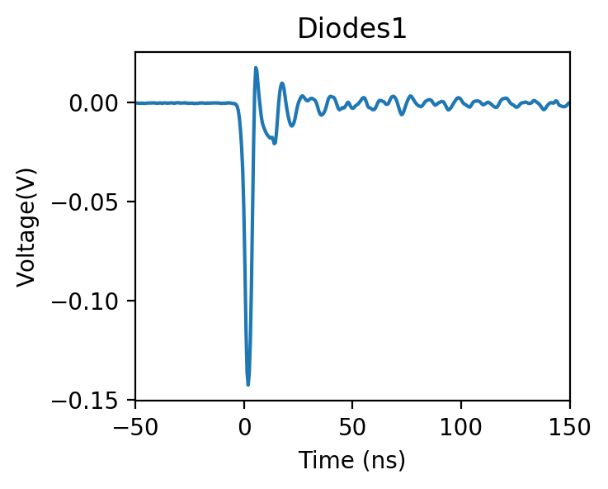
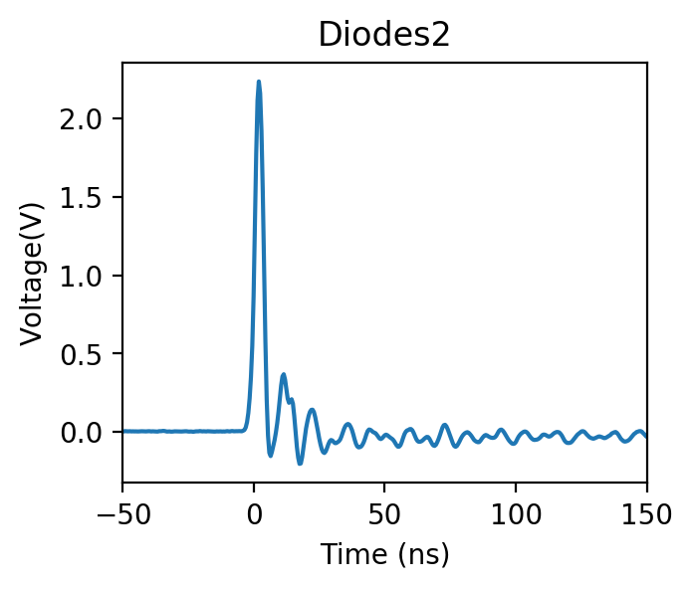
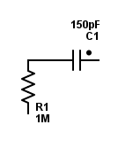
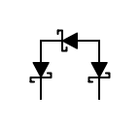
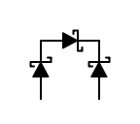
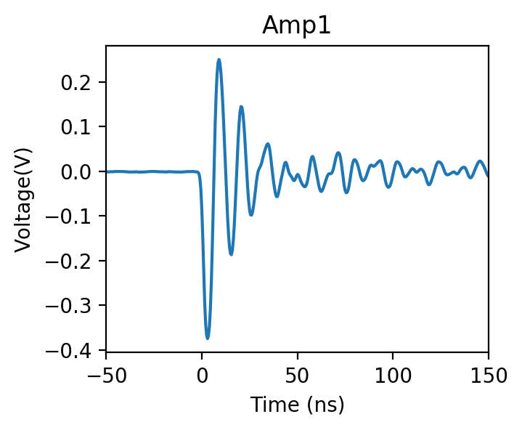
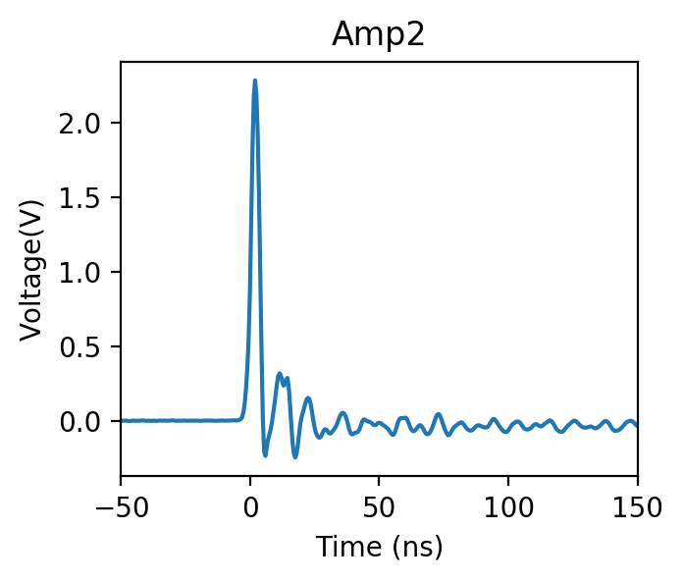
In more detail...
time tagger
ENI 600L
ZFL-500LN+
2500 V

Slide 33
The basic idea + improvements
AWG
on/off pulse
start pulse
extraction pulse
DAC
390 nm
422 nm
e⁻
time tagger
PI lasers
Trap
MCP
stop pulse
Ca
oven

Slide 34
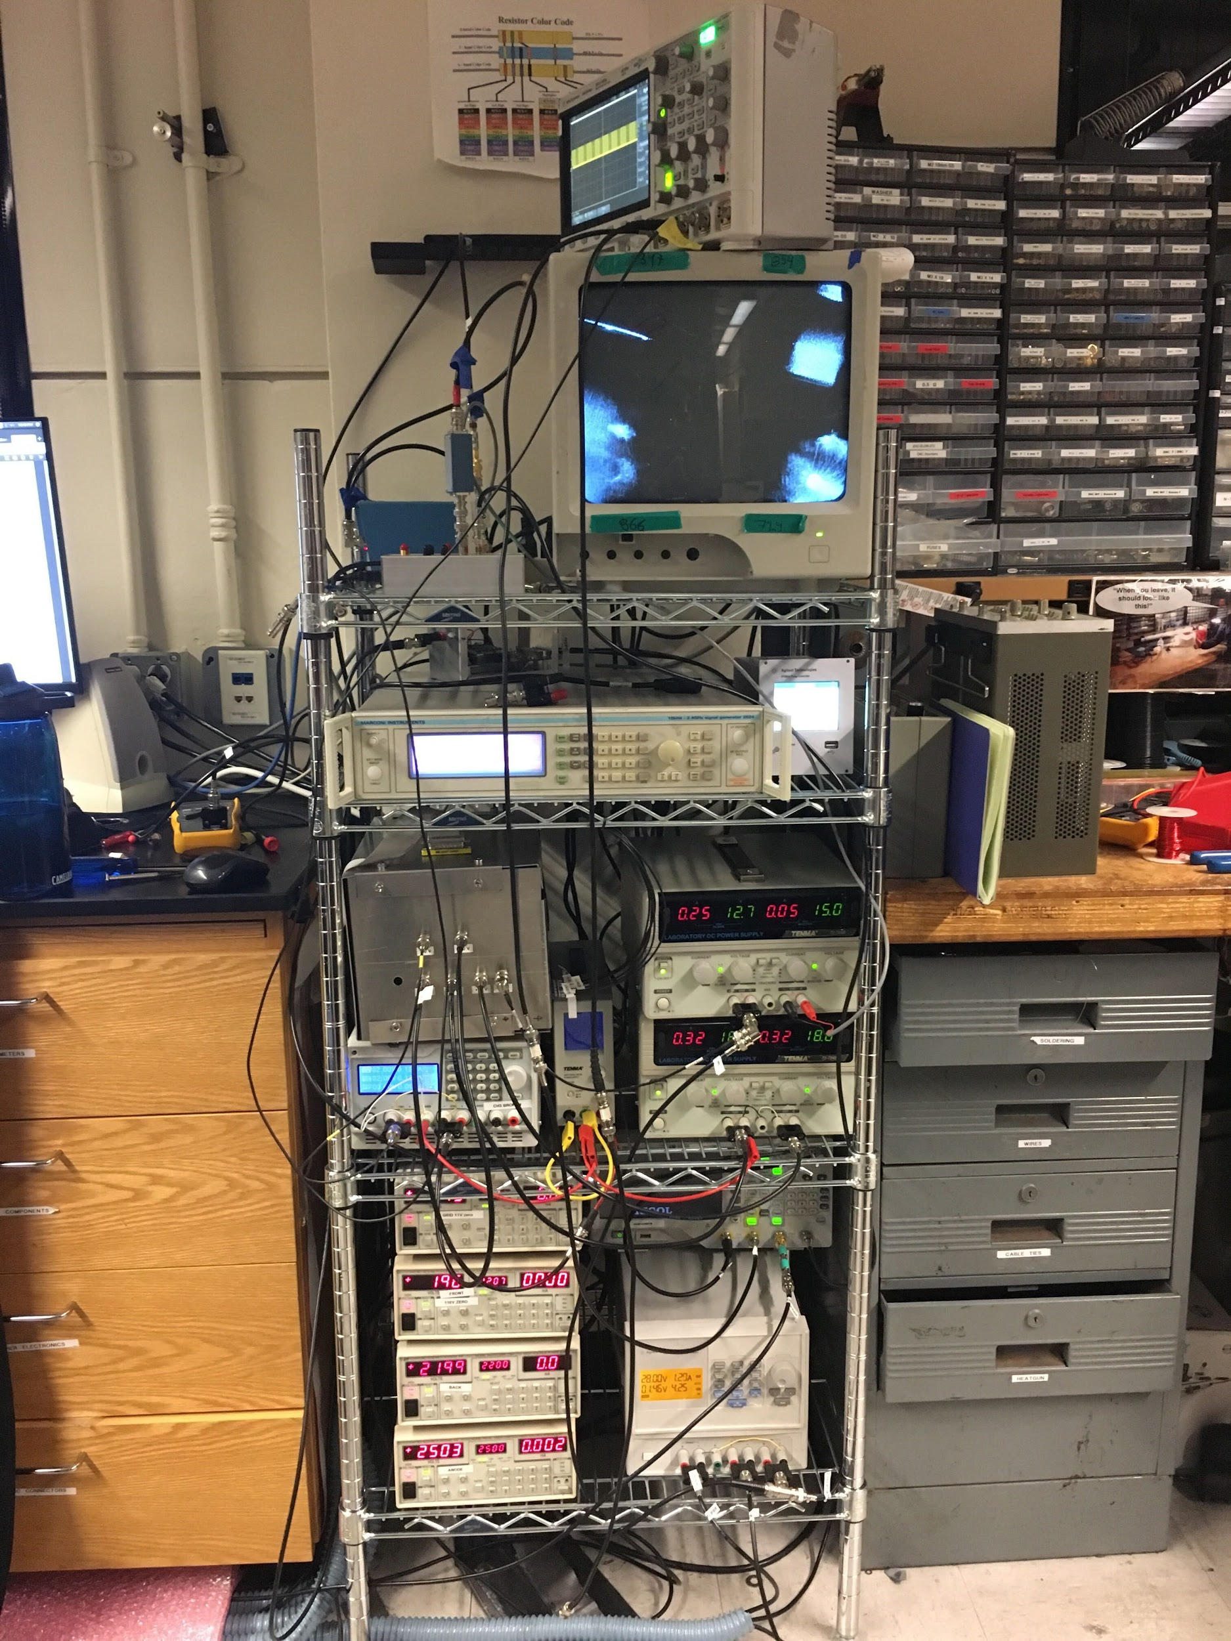
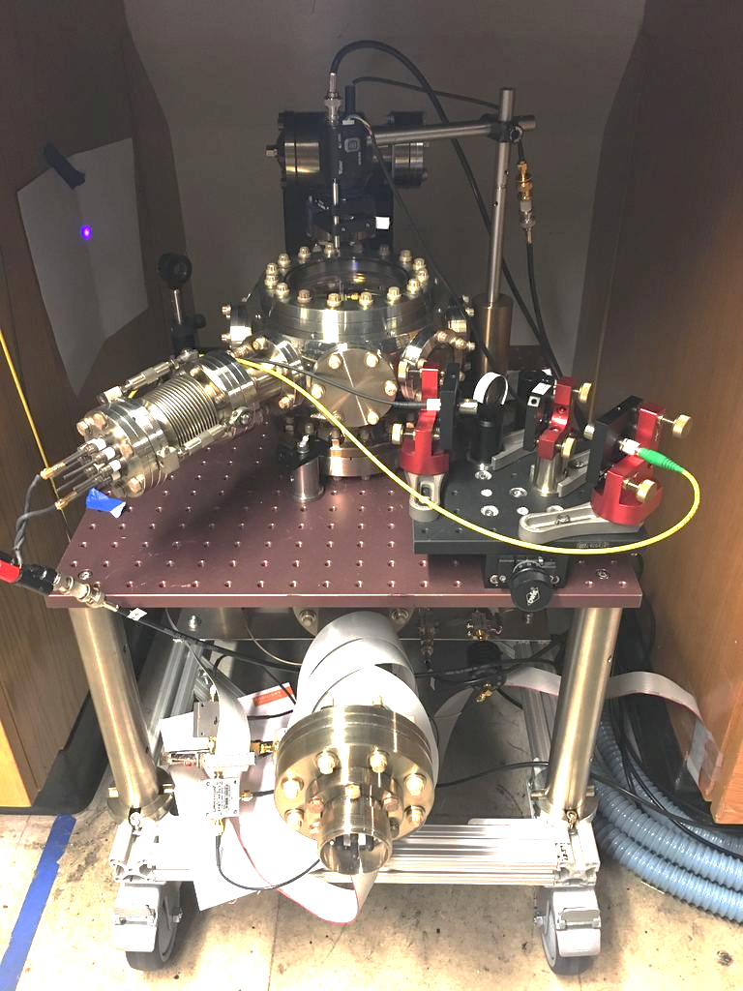
Trapping electrons
The experiment

Slide 35
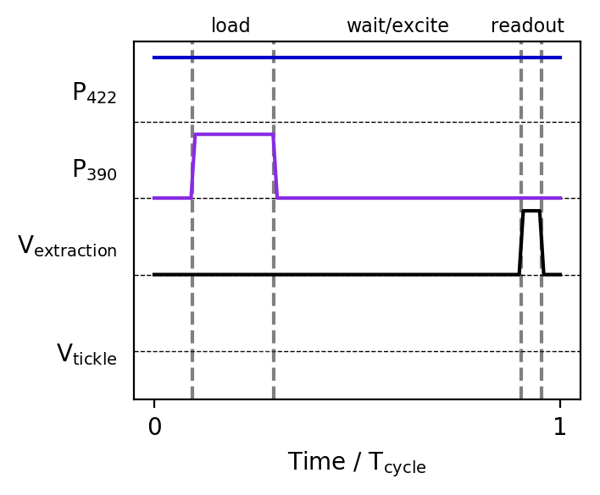
Measurement Protocol

Slide 36


Slide 37

Measurement Protocol

Slide 38

Electron loading

Slide 39

Electron storage

Slide 40
The basic idea + improvements
AWG
on/off pulse
start pulse
extraction pulse
SG
DAC
tickle
390 nm
422 nm
e⁻
time tagger
PI lasers
Trap
MCP
stop pulse
Ca
oven

Slide 41


Trap frequencies

Slide 42
Next steps ?
Vision
Expected features:
- All electronic operation
- Gate speed: 10 - 100 ns
- Coherence time: >1 s
- Temperature: 0.1-4 K

Slide 43
Next steps
Vision: an electron quantum computer
towards a quantum computer:
Detect electrons via image charges
Detect spin direction
Implement quantum gates
Shuttle electrons => scalable quantum computer
Preparation:
Detailed feasibility study
Current expected limit for error rates ~ 10⁻⁶.
Shrink trap size stepwise from 1 mm to 30 µm
=> increases trap achievable frequencies to ~ 2 GHz
=> allows for a large magnetic field gradient
Go cryogenic
=> allows for cooling to prepare for electronic detection

Slide 44








The group
Team:
Clemens Matthiesen
Qian Yu
Alberto Alonso
Timothy Guo
Past:
Thanks:
David Root
Sonali Sarpotdar
Nikos Daniilidis
Pai Peng

Slide 45
Summary
Trapped electrons for the first time in a Paul trap
Many seconds of lifetime (for some of the electrons)
Up to 300 MHz trap frequency
First (and most important?) step towards a quantum computer

Slide 46




Trapping electrons
Keeping trap parameters the same:
- Stability parameter
- Trap depth
And hence:
Take a normal ion trap and drive it at 1 -10 GHz

Slide 47



Thermal imaging is cool

Slide 48



Ejection pulses
Want to apply to 3 electrodes:
Rigol: 20 V pulses with -10 V offset
Use BNC T and power splitter to split into 3 lines
Use bias-T to add to electrode DC voltage
Measure pulses at Dsub connector: 13 V, 9V

